Slide 1


Saint Mary’s Catholic Primary School
MEET THE TEACHER
SEPTEMBER 2026
Nursery

Slide 2
Class Teachers
Miss Lankester
Teaching Assistants
Nursery
Mrs Borg-Heffernan

Slide 3
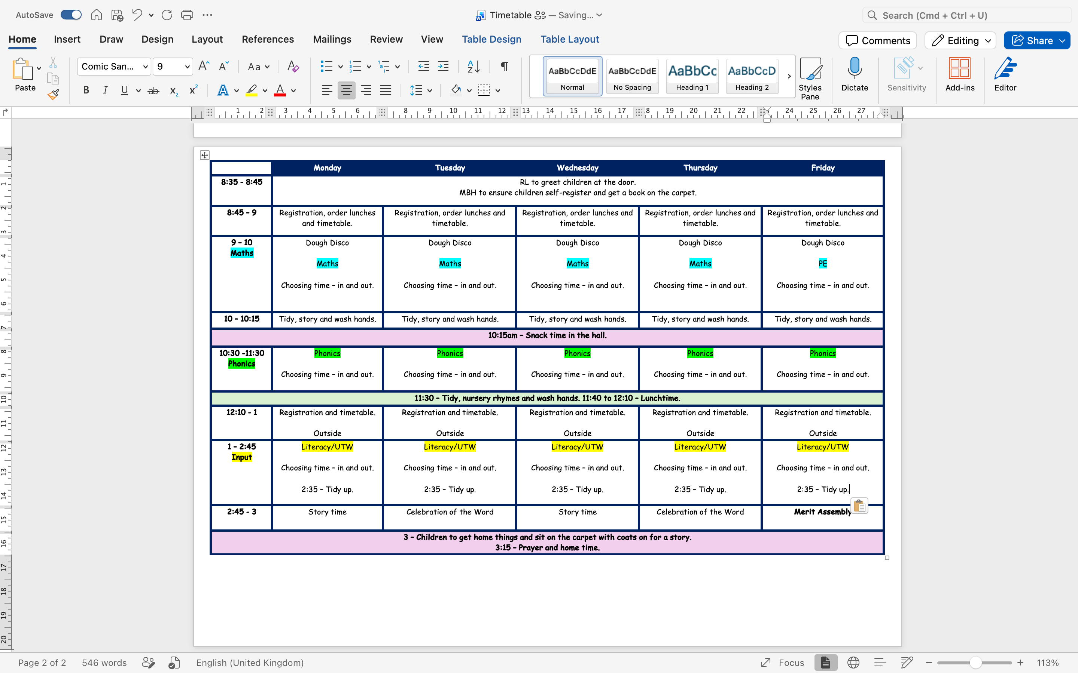
Timetable

Slide 4
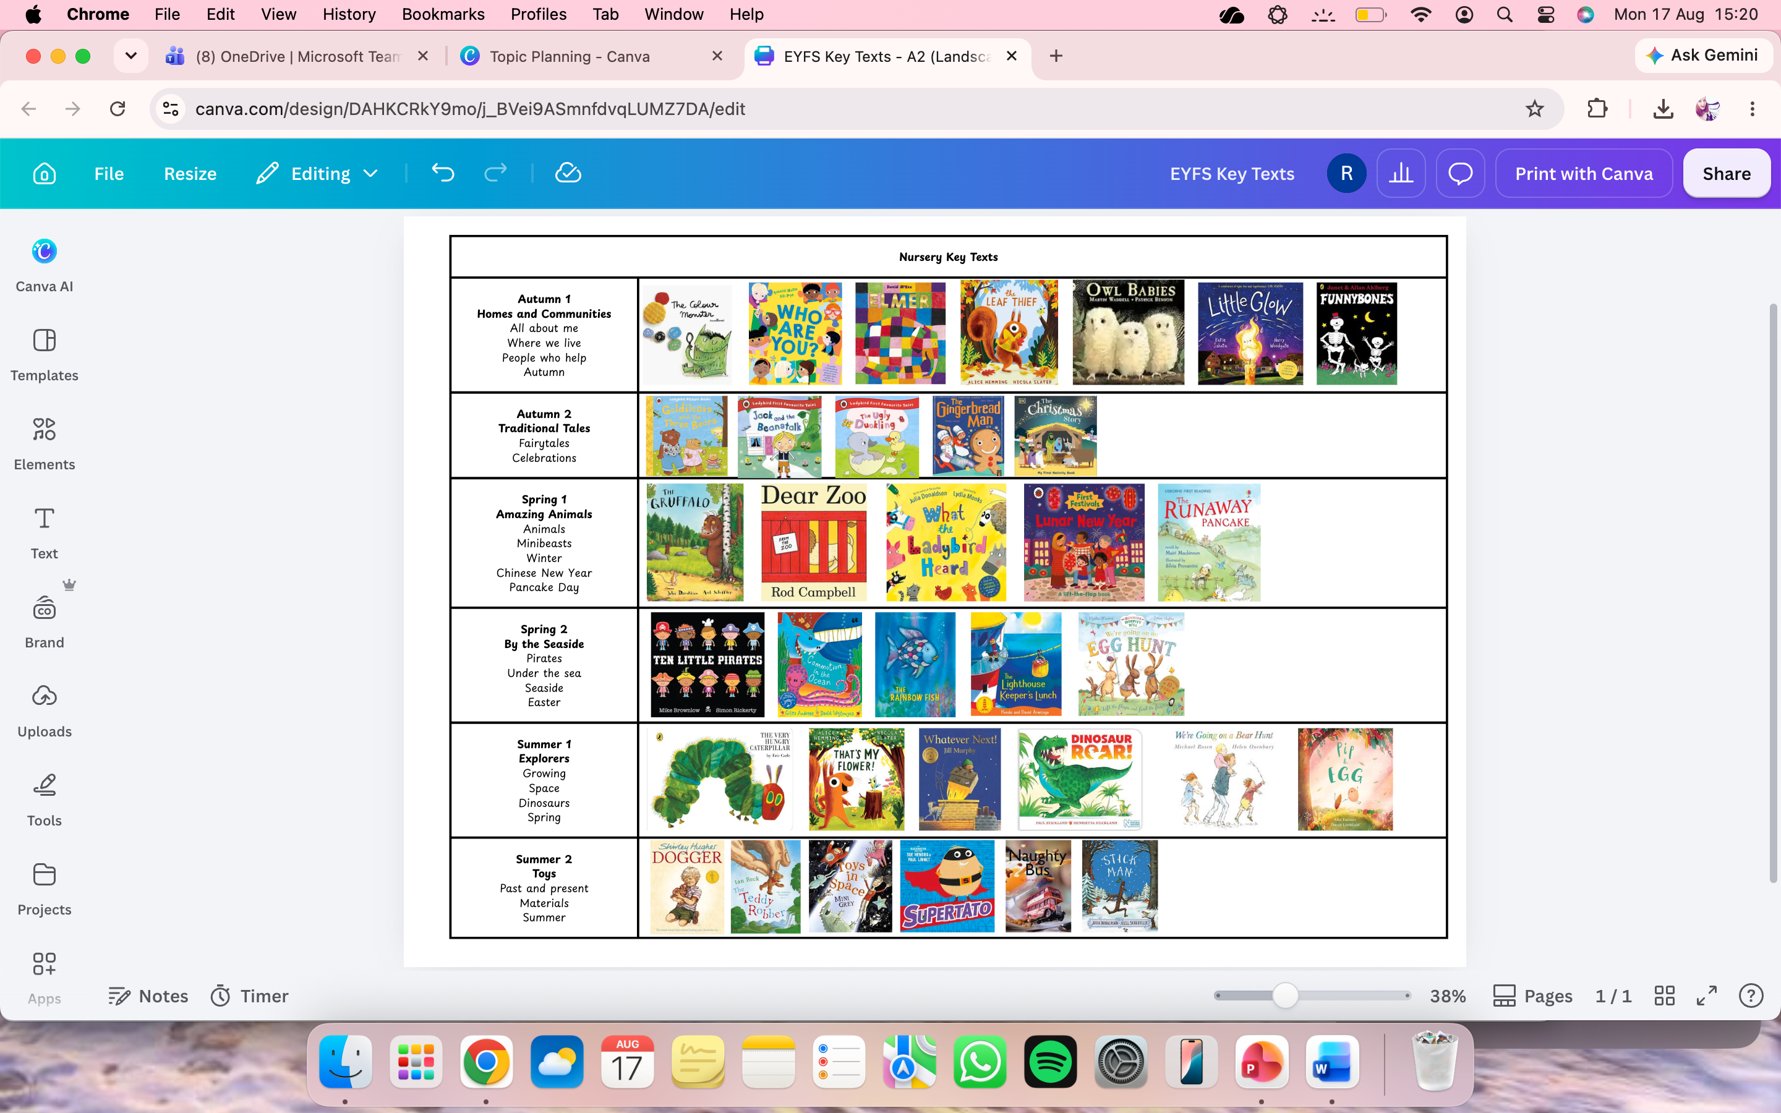
Topics
  Each half-term, we have an over-arching topic in the EYFS. We use high-quality texts to guide and support the children’s learning and expose them to a range of themes and experiences.

Slide 5


We use the Monster Phonics scheme to teach phonics. The children love all the Monsters and will start to learn sounds based on the matching Monster and colour! E.g., all ‘A’ sounds are Angry Red A!
Phonics

Slide 6
We teach phonics everyday in Nursery. We focus on Phase 1 phonics: environmental sounds, instrumental sounds, body percussion, voice sounds, rhythm and rhyme, alliteration and oral blending and segmenting.
The government Phase 1 curriculum consists of 7 aspects. Each aspect contains 3 strands:
Tuning into sounds (auditory discrimination)
Listening and remembering sounds (auditory memory and sequencing)
Talking about sounds (developing vocabulary and language comprehension
Phonics

Slide 7
When teaching sounds at home, use ‘pure’ sounds (not the alphabet sounds!).
For writing, we focus on pattern formation and name writing. Please teach lowercase letters except for the first letter of their name ☺
Phonics

Slide 8

Maths activities are taught daily. Maths in Nursery includes singing songs, completing puzzles, and playing games.
By the end of Nursery, children should be able to confidently count forwards to 5 and backwards from 5, count out up to 5 objects, talk about the properties of some 2D and 3D shapes, use positional language (on top, under, next to), create simple ABAB patterns (e.g., red, yellow) and be able to compare different sizes, heights, weights, volumes and capacities.
Maths

Slide 9


We use Class Dojo for:
Behaviour management (green dojos and red dojos)
Whole class communications/weekly class information
All messages to go through the office (admin@saintmaryscongleton.co.uk)
If needed, I may contact you to let you know how your child has settled ☺
Child portfolios – individual image sharing, reading at home
If you read a story with your child at home, upload it to their ClassDojo portfolio to receive 2 extra green dojos per read! (one per day)
We use EvidenceMe for:
Uploading learning and keeping learning journeys for the children
Learning is linked to the EYFS areas of learning so you can keep what we are learning and where the links are to the curriculum ☺
Class Dojo and Evidence Me

Slide 10

What can you do to help?
  Read regularly with your child- storybooks, library books, online books, magazines, newspapers, ANY THING!
  Play with your child and talk to them about their play. Ask them questions about their activities and encourage conversation and confidence!
  Develop independence – putting on shoes, doing their coats, using cutlery etc.

Slide 11
  Filled water bottle that is clearly named
  Spare clothes (labelled)
  Appropriate clothing for the weather
  Please refrain from bringing any other belongings from home. Toys tend to cause a lot of upset and may get lost!
  Healthy snacks will be given to the children at snack time. Please feel free to pack a healthy snack if you prefer.
What to bring each day

Slide 12
Expectations
  Please ensure that all clothing and belongings are clearly named.
  Children are to wear PE kit to school. This comprises of a navy t-shirt, navy shorts or joggers, a navy jumper, and trainers.
  Children to bring a named puddle suit and wellies to keep in school.
  On Forest School days, children must wear long-sleeved tops and trousers, and bring coats/footwear that you don’t mind getting muddy!
BEHAVIOUR AND
EXPECTATIONS

Slide 13
  Some exciting enrichment activities we have planned:
  Welly walks for the different seasons
  Mystery Readers (any volunteers?)
  Library visit
  Nativity
  Visit from Zoo2U
  Ducklings
  Caterpillars
  Planting seeds
  Church visit
  Farm visit
  Zoo Visit
  People who help – firefighters, ambulance etc
  Teddy bear picnic
Enrichment

Slide 14
IF YOUR CHILD IS ABSENT PLEASE CALL SCHOOL IN THE MORNING AND LEAVE A MESSAGE
ABSENCE AND ATTENDANCE
CHILDREN ARE NOT TO RETURN TO SCHOOL UNTIL 48 HOURS AFTER LAST BOUT OF SICKNESS AND DIARRHOEA.

Slide 15
  If your child has any allergies or requires medication during the school day, please ensure we are kept fully informed of these.
IMPORTANT INFORMATION
  In relation to any medicines, please ensure the relevant forms are completed and signed from the office and all medication provided is within date.
  We do not allow nuts or products that contain nuts in school. This is to ensure all of our children are kept safe at all times.
  Please leave toys at home!
  Volunteer helpers? Trips, mystery readers etc.
  Nits- please ensure you check your children's hair regularly, inform us if these are discovered and treat these immediately.

Slide 16
  If you need to contact us we have an open-door policy at all times.
CONTACT
  You can contact us by email on admin@saintmaryscongleton.co.uk
  We are also available for phone calls too and these can be arranged through the school office. Regular parent drop-ins when progress and any concerns can be discussed.

Slide 17
Thank you!
DO YOU HAVE ANY QUESTIONS FOR ME BEFORE WE GO?

