Slide 1


Saint Mary’s Catholic Primary School
MEET THE TEACHER
SEPTEMBER 2026
YEAR 3

Slide 2


Class Teachers
Mrs Burrow (Monday, Tuesday & Wednesday) & Mrs Waters (Thursday & Friday)
Teaching Assistants
Mr Cavanagh, Mrs White & Miss Manley

Slide 3
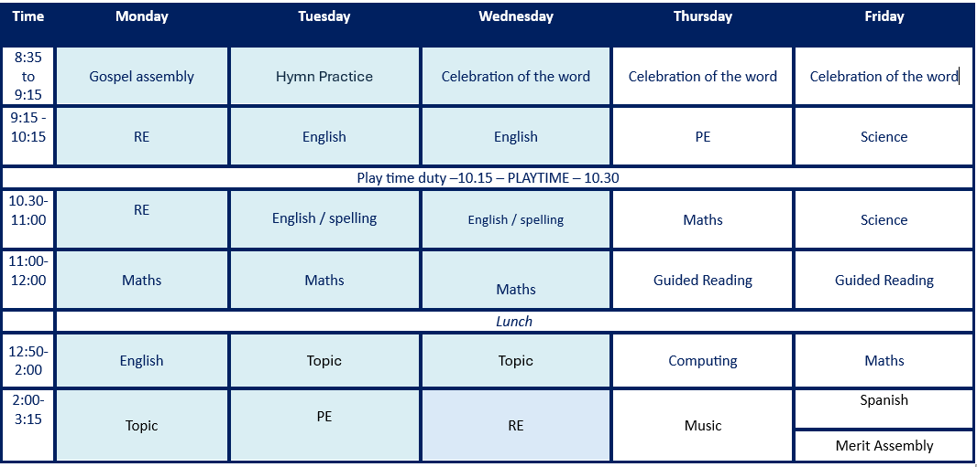
Timetable

Slide 4







English
  This will be taught through the Pathways to Write Scheme. All
units are linked to high-quality texts to ensure engaging and purposeful lessons are delivered.
SUMMER 2 – THE MERCHANT OF VENICE
  The units of work are aimed to develop vocabulary, reading and writing skills through the mastery approach.
  The scheme includes strategies to develop Greater Depth writers.
SUMMER 1 – JOURNEY
AUTUMN 1 – COUNTING ON KATHERINE
AUTUMN 2 – CLOUD TEA MONKEYS
SPRING 1 – STONE AGE BOY
SPRING 2 – BIG BLUE WHALE.

Slide 5

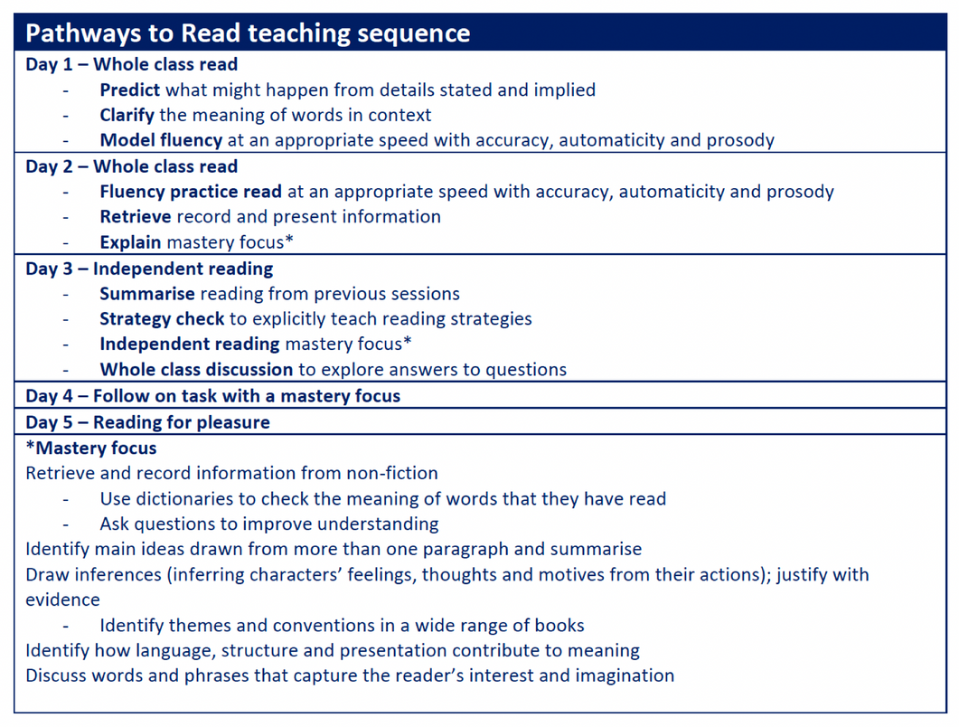
-Every half term we will be covering a
different class guided reading book.
Guided Reading Book
-Our first is ‘The Sea Book’
by Charlotte Milner.

Slide 6
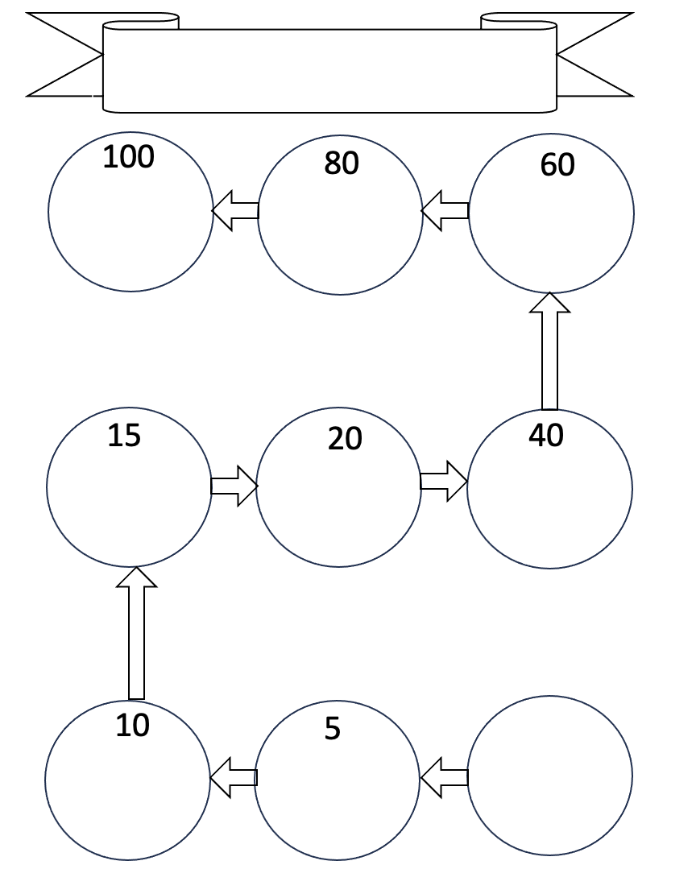

Our reading reward system!
Reading
-
Each child will be given a card and they can collect stickers and class dojos based on the number of reads at home that they have completed.

Slide 7

Our New KS2 Reading Scheme
Matched to Ability: Every KS2 child has been carefully assigned a reading book that is perfectly suited to their current reading ability to ensure confident progress. The children were assessed at the end of the previous academic year, ready to hit the ground running from September.
Reading at Home: Reading regularly at home is vital for your child's development. Please read with them and sign their reading record.
Looking After Books: Please take great care of our school books and ensure they are returned to school daily.
-
The 'Green Pen' System: Teachers and TAs will use a green pen to write in your child's reading record. This makes it simple to distinguish between school reads and home reads!
Getting Started: Reading books and their designated reading folders will be sent home after all Meet the Teacher meetings have concluded this week.

Slide 8
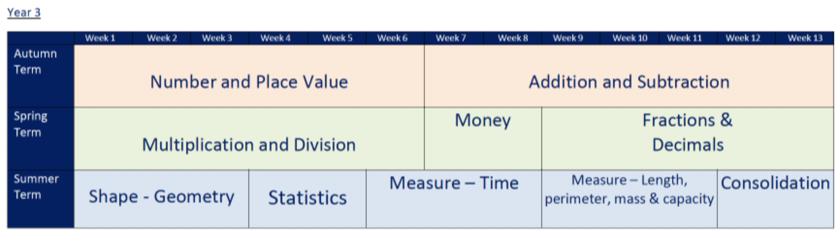
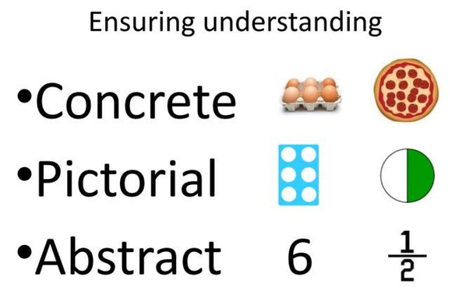
Maths

Slide 9
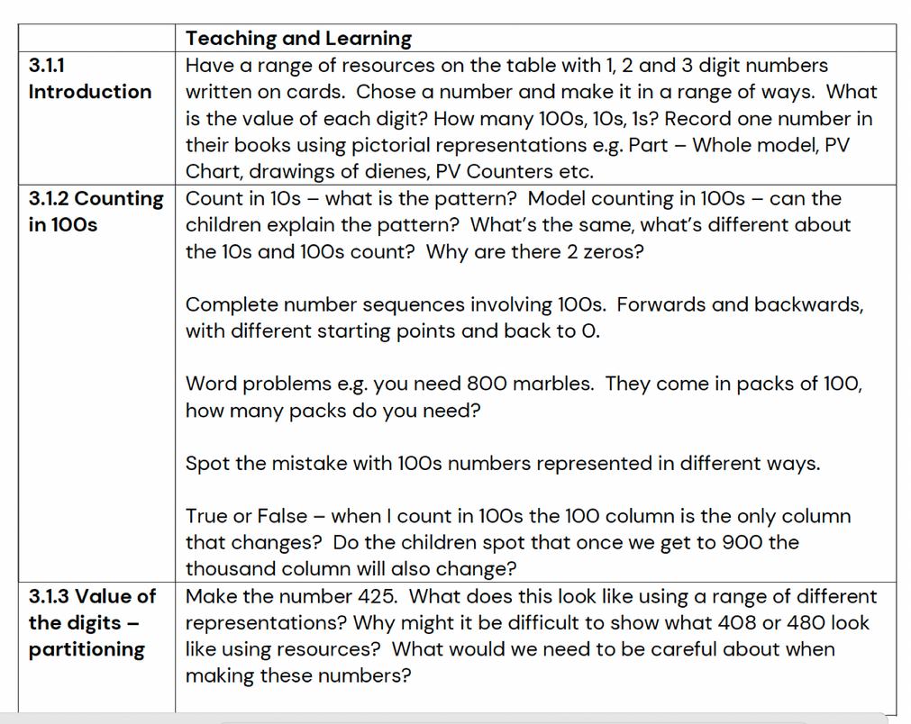
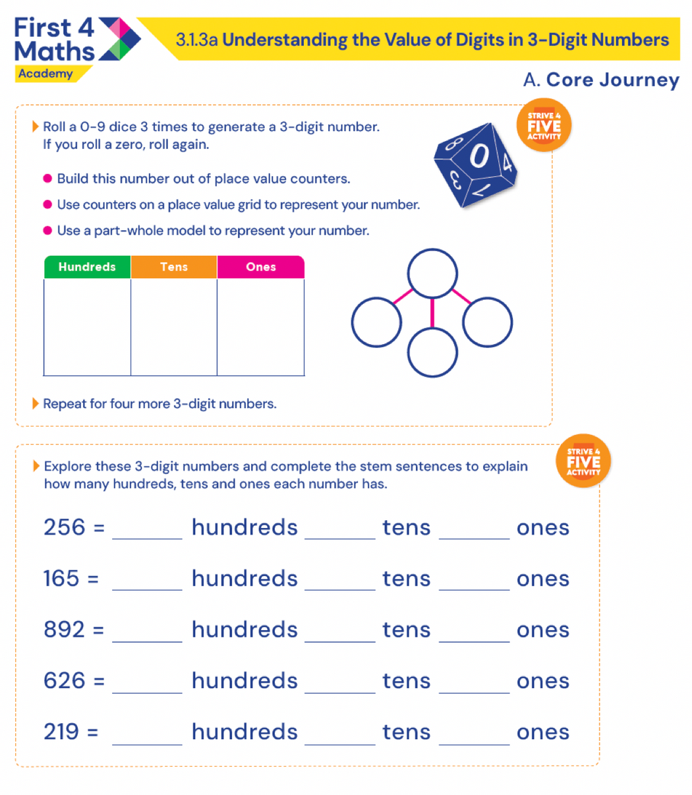
Maths.
VARIED FLUENCY

Slide 10
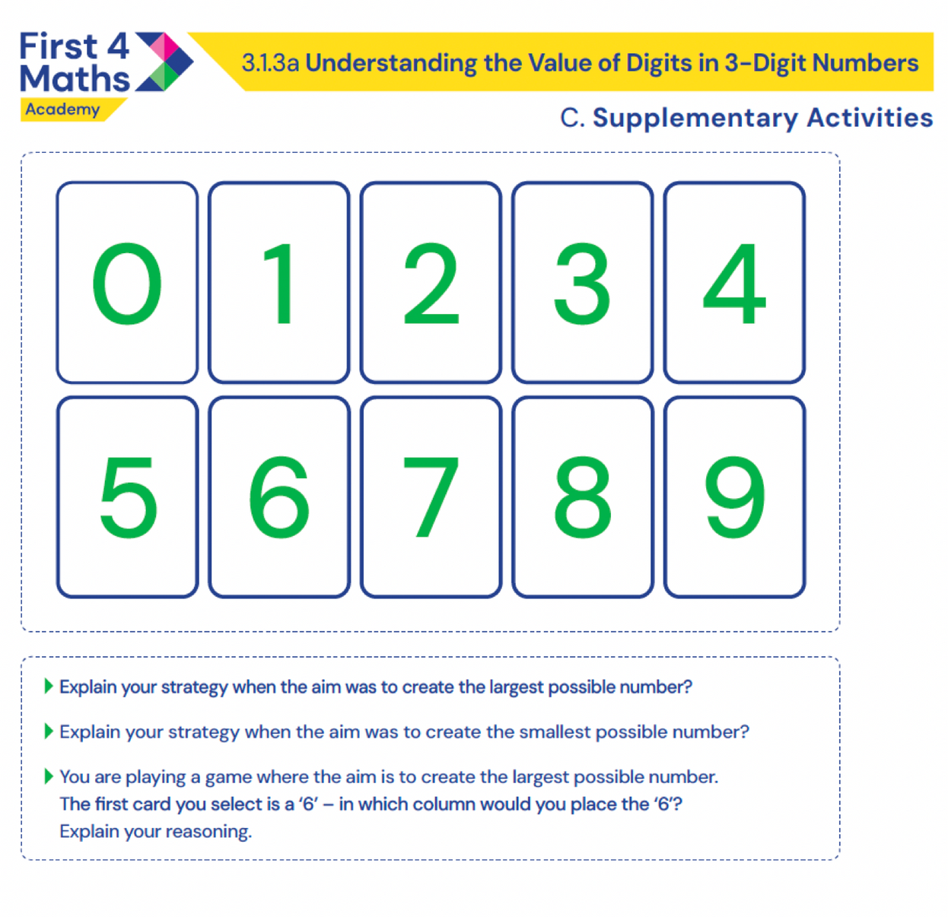
Maths.
REASONING AND PROBLEM SOLVING

Slide 11

  Times tables are very important and will be a big focus in preparation for Year 4 times tables test.
Maths.
  By the end of Year Three, the children need to be competent with their 2s, 5s, 10s, 4s, 8s, 3s and 6s. We will be having regular tests on these in school, starting with 2s this week.
  Another aspect of maths, that the children really need to focus on is time. We won’t be covering this until later in the year, but the more the children can practice time at home the more they will be prepared for this particular unit

Slide 12
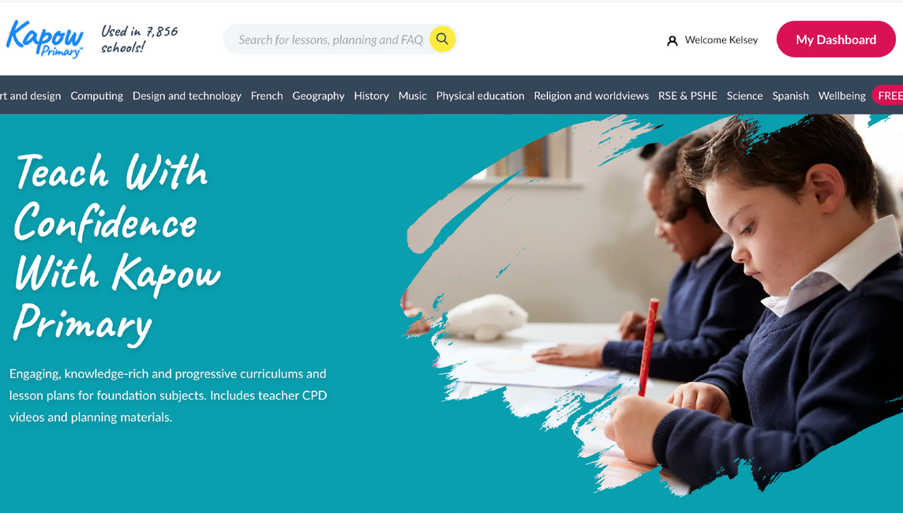
Foundation Subjects
  You will find termly information on Science, History, Geography, Art and D&T on our webpage.
  You will be able to read the knowledge organisers for each subject that we are doing for that half term.

Slide 13



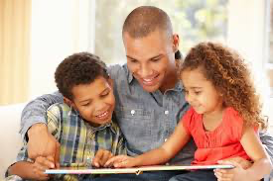


What can you do to help?
  Read regularly with your child- school books, books at home, library books, online books, magazines, newspapers, ANY THING!
  Question your child about what they have read and encourage them to use their developing phonics knowledge to decode unfamiliar words.
  MyMaths/Atom learning- Use the login details to access the MyMaths & Atom Learning activities. The use of these websites will be reviewed this year as we continually assess and monitor the best resources we can make available. We shall be sticking logins into the children’s reading records.
  Letter-Join: Cursive handwriting practise, resources to support
  this on the website.

Slide 14
Phonics
Reading
Timetables
Precision teaching
Maths catch up
Boosters and interventions

Slide 15
Expectations
  Please ensure that all clothing and belongings are clearly named.
  Children are to wear either their summer or winter uniform until October half term, but after this time they must be in winter uniform.
BEHAVIOUR AND
  No trainers are allowed, except on PE days
(children should come into school in their PE kids on a Tuesday and Thursday). No jewellery.
EXPECTATIONS
  Please ensure your child has a labelled water bottle in school daily.

Slide 16

Behaviour
  We follow our Golden Promises and these are shared in assembly and in class so that everyone understands how we behave at Saint Mary’s.
  If any issues arise that we need to discuss with you then you will be contacted. The behaviour policy is on the website.
Expectations
  All clothing and belongings to be clearly named eg lunchbox, snack boxes, water bottles, caps.
  Children to come into school in the correct uniform eg only trainers on PE days. Jewellery should not be worn. Hair to be tied up if longer than shoulder length.

Slide 17
First Holy Communion
Children who are Baptised Catholics will make their Sacrament of Reconciliation and First Holy Communion in Year 3.
Children will begin their preparation through after school sessions which will start around February time.
The Sacrament of Reconciliation will take place in March.
The Sacrament of First Holy Communion will take place in May.
Exact dates will be communicated with you, once agreed with Fr Francis, and you will be invited to a meeting before the preparation process begins.
In the meantime, we encourage these children to attend Mass as regularly as possible.

Slide 18
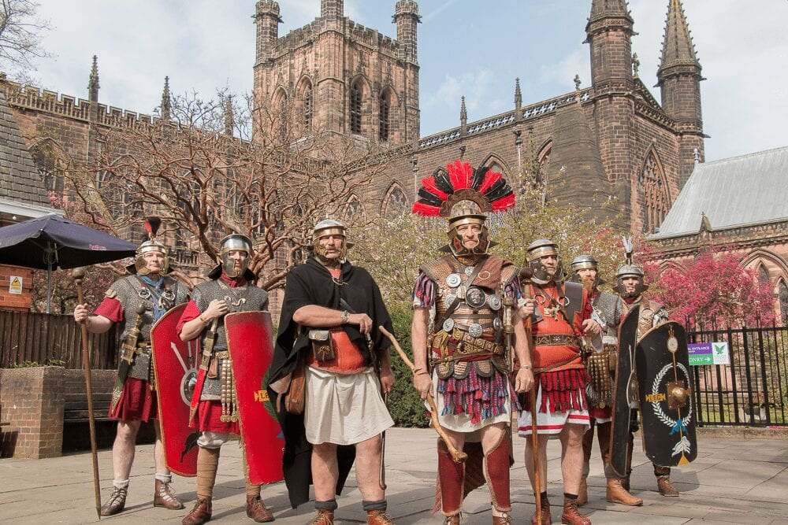
During the Spring term, as part of our history unit about the Romans we will be visiting Chester and having a tour of Chester and Chester Musueum, led by a Roman Centurian. This trip was fantastic last year and it really helped to bring our learning alive.
TRIPS

Slide 19
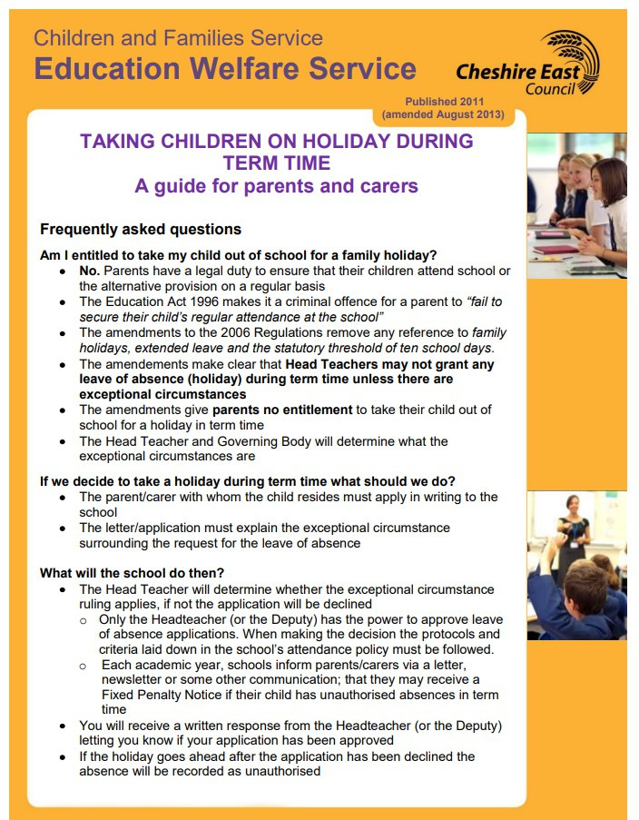
ABSENCE AND ATTENDANCE

Slide 20
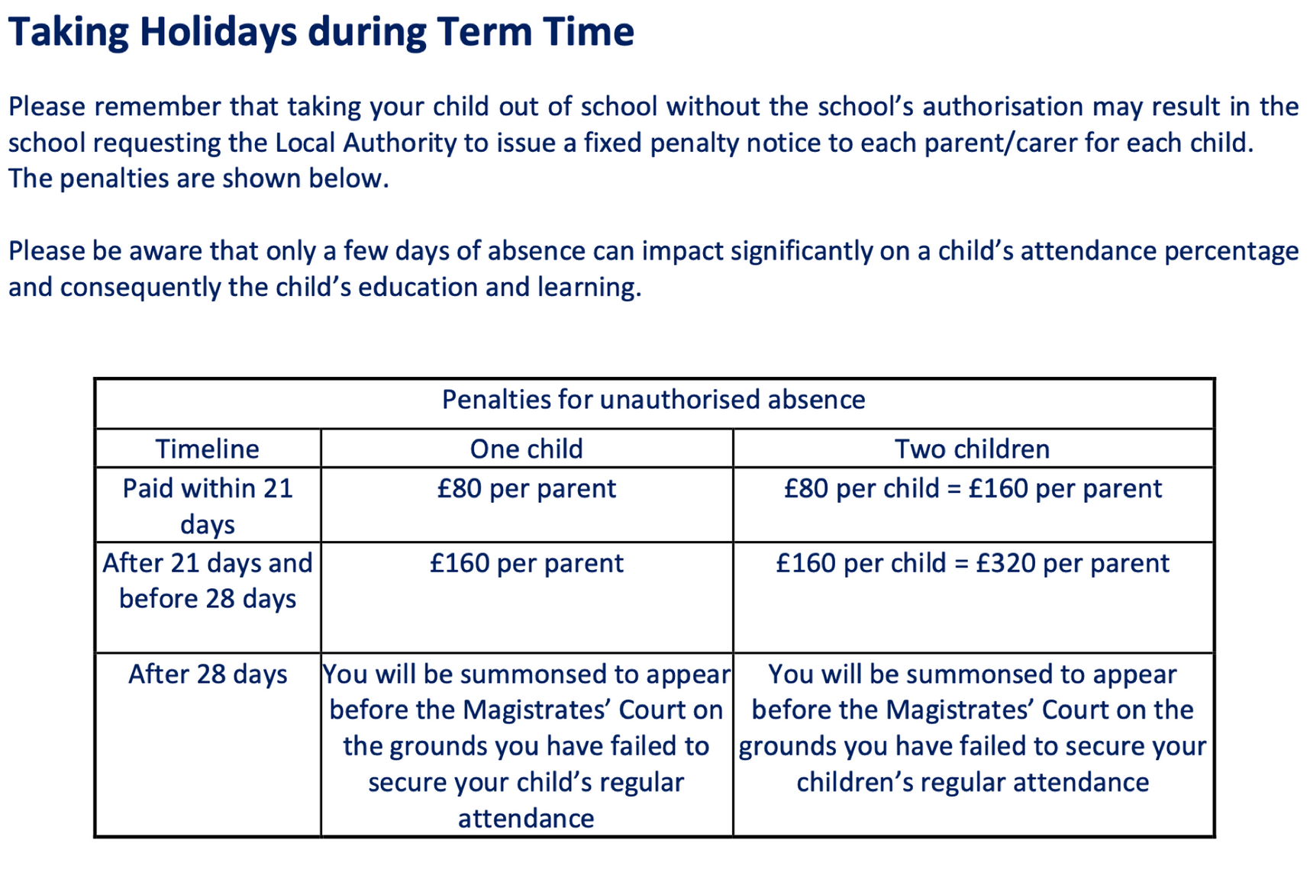
IF YOUR CHILD IS ABSENT PLEASE CALL SCHOOL IN THE MORNING AND LEAVE A MESSAGE
CHILDREN ARE NOT TO RETURN TO SCHOOL UNTIL 48 HOURS AFTER LAST BOUT OF SICKNESS AND DIARRHOEA.

Slide 21
  If your child has any allergies or requires medication during the school day, please ensure we are kept fully informed of these.
IMPORTANT INFORMATION
  In relation to any medicines, please ensure the relevant forms are completed and signed from the office and all medication provided is within date.
  We do not allow nuts or products that contain nuts in school. This is to ensure all of our children are kept safe at all times.
  Please leave toys at home!
  Volunteer helpers?
  Nits- please ensure you check your children's hair regularly, inform us if these are discovered and treat these immediately.
  In relation to break time snacks, please ensure these are healthy and are of a suitable size.

Slide 22
  If you need to contact us we have an open-door policy at all times.
CONTACT
  You can contact us by email on admin@saintmaryscongleton.co.uk
  We are also available for phone calls to and these can be arranged through the school office and will have regular parents evenings when progress and any concerns can be discussed.

Slide 23
Thank you!
DO YOU HAVE ANY QUESTIONS FOR ME BEFORE WE GO?

