Slide 1
Year 6 Parents Meeting
SATS

Slide 2
When is SATs Week?
In 2026, Year 6 SATs week will take place on the week beginning Monday 11th May. The SATs tests will take place throughout the week, starting on Monday 11th and ending on Thursday 14th May.
Monday, May 11, 2026: English Grammar, Punctuation & Spelling (GPS) Papers 1 & 2.
Tuesday, May 12, 2026: English Reading Test.
Wednesday, May 13, 2026: Mathematics Paper 1 (Arithmetic) & Paper 2 (Reasoning).
Thursday, May 14, 2026: Mathematics Paper 3 (Reasoning).
About 17 weeks away.

Slide 3
How can I help my child prepare?
Daily and regular habits
Reading at home (even 10–15 mins daily). Encourage independent reading and reading together to check for understanding. Talk about the book together. It is not just a listen and sign the diary exercise.
Times tables practice. Quick recall really helps with maths fluency. If your child struggles with times tables, using songs can help or creating other strategies.
Encourage writing. Stories, diaries or short paragraphs build confidence. Check and correct them together. If you don’t feel confident yourself, take a picture of the work and ask Chat GPT to look for errors.
Useful revision activities
Practice SATs-style questions together. These are usually found in CGP books or similar revision-style books.
Use short, structured practice sessions rather than long, tiring ones. Place notes around the room for aspects your child tends to forget and needs to remember. Your child might be able to identify the aspects they always forget about.
Make use of online resources. YouTube videos and SPAG.com for grammar.
Daily routines
Consistent bedtime and morning routines — well-rested children do better.
Balanced screen time so focus can be on learning and sleep.
Attend school.
Practise handwriting.
Learn the 5/6 spellings.

Slide 4
Emotional & Practical Support
Talk about positive effort rather than “test performance”. For example, “Your score went up by two since the last time!”
Encourage your child to ask an adult, speak to a teacher or use the internet to learn with aspects they aren’t sure about.
Keep home as a supportive, low-stress environment especially during SATs week. It is advisable not to overload your child at this point. There is only so much that your child can absorb and retain! We want children to have a love of learning and education!

Slide 5
Some links!
Websites: Mathsbot Year 6 Arithmetic https://mathsbot.com/primary/ks2
Mathsframe https://mathsframe.co.uk/en/resources/category/22/most-popular
Spellingframe https://spellingframe.co.uk/
Rollama https://rollama.com/index-games-toggle.php solo free games
MC Grammar –tenses and word classes e.g. https://www.youtube.com/watch?v=4prb1Vuu_m4
Word classes: determiners, prepositions, conjunctions, nouns, adverbs, verbs, pronouns,
Tenses: past simple, present simple, past progressive, present progressive, past perfect, present perfect
Grammarsaurus songs
e.g. https://www.youtube.com/watch?v=fhSXk0awQAA

Slide 6
Maths - What do this class need work on in particular?
Times table recall.
They need speedy and instant times table recall as this speeds up so many other areas of maths!
Fractions
Can they add, subtract, multiply and divide fractions with ease?
We are yet to cover this in class, but it is always a topic that needs more time!
Converting between fractions, decimals and percentages.
Can they convert between these with ease. For example, do they know that 0.2 is ⅕ and 20%?
Addition, Subtraction, Multiplication and Division.
Can they use column addition, column subtraction, short/long multiplication and short/long division correctly every time correctly!
Some of this was covered in year 5, but we move on to the percentages and converting between the three!

Slide 7
Grammar - What do this class need work on in particular?
Recalling different types of noun
They need to know the difference between a noun, proper noun, pronoun, abstract noun.
https://www.twinkl.co.uk/resource/t2-e-253-types-of-nouns-display-poster-large
Suffixes and Prefixes
Do they know what suffixes and prefixes are and how to add them to root words? For example the ‘im’ in impossible is a prefix and changes the meaning of it.
Root words
Do they know the root words of a word? For example, do they know that the root word of graceful is grace?
Changing active to passive, or passive to active.
Do they know the difference between active and passive? Can they change sentence from active to passive?
For example:
Active:
The dog chewed the toy.
Passive
The toy was chewed by the dog.

Slide 8
Reading - What do this class need work on in particular?
Pace
The children have to read three texts in the space of an hour and answer three lots of questions! For homework, time the children to read the text and answer the questions in under 20 minutes. Plenty of practice papers are available on Twinkl or to buy from TG Jones!
Impressions
Can they give impressions about what a character is like and give evidence from the text?
Effort
Some children need to work on their focus and effort when it comes to reading. The more they put in to focus, the more they can get out of it! Make sure they have slept well and have eaten!
3-mark questions
Some children often avoid 3-mark questions. They seem big and scary. Break down these problems into small steps. Make a point and then give the evidence, then repeat.

Slide 9
Writing - What do this class need work on in particular?
Spelling
Practice the Year 3/4 and Year 5/6 spellings at home!
https://cdn.oxfordowl.co.uk/2019/08/29/13/54/08/76f1443d-9b6d-4030-be0d-25fcfef01438/SpellingWordList_Y3-4.pdf
https://cdn.oxfordowl.co.uk/2019/08/29/13/56/09/5a42eb6a-f57f-4dc4-a66e-bd4c5e27e4b7/SpellingWordList_Y5-6.pdf
Checking
Can they check their work for common errors! Capitals and full stops!
Good readers = good writers.
good readers are almost always good writers because reading exposes you to style, structure, vocabulary, and rhythm, but being a great writer also requires active analysis of what you read and consistent writing practice, not just passive consumption.
Does it make sense?
Some children write their sentences and then don’t read them aloud to themselves. Is it coherent? Can you read it without getting confused?
Write, write, write!
Write short stories, diaries, recounts of the day together! It will be great bonding with your child and it will help your child!

Slide 10
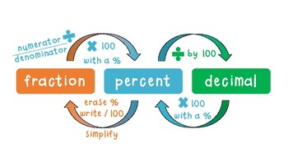
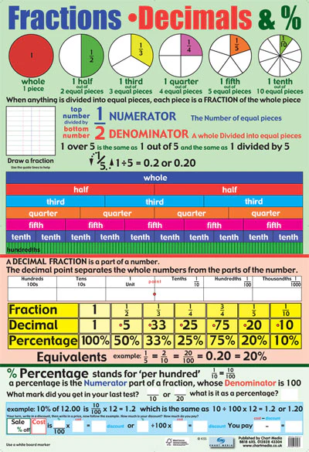
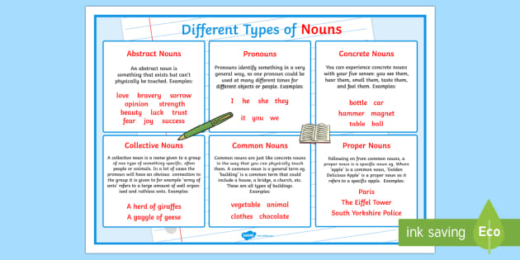
Posters - buy or print!

Slide 11
Resources
1. Twinkl
A huge collection of Year 6 SATs practice worksheets, activity mats, revision packs and parent guides. Many resources are printable once you’ve created a (free or paid) account. Twinkl
2. White Rose Maths (Home Learning & Worksheets)
Provides maths home-learning lessons and worksheets suitable for Year 6 and aligned with curriculum objectives, plus videos. Free downloadable worksheets are available for parents. whiteroseeducation.com+1
3. BBC Bitesize (KS2 Section)
A free educational hub with subject-specific revision, quizzes and activities for KS2 Maths and English that support SATs topics. Wikipedia
4. YearSix.co.uk (Past Papers & Practice)
Offers Year 6 SATs past papers that parents can use for additional practice at home.
We usually ask that parents don’t complete the past SATs papers as we do them in school, and it will give us an unrealistic view of their data. We have, however, completed the 2022 and 2023 papers, so feel free to use them again if you wish!

Slide 12
Attending Booster Groups
If your child has been invited to a booster group, please help by encouraging them to attend.
Children who walk home have been known to walk back home instead of attending!
However, we understand if you really can’t attend due to work/time limitations!

Slide 13
IMPACT OF ATTENDANCE
Quotes taken from https://educationhub.blog.gov.uk/2023/05/school-attendance-important-risks-missing-day/
“Being in school is important to your child’s achievement, wellbeing, and wider development. Evidence shows that the students with the highest attendance throughout their time in school gain the best GCSE and A Level results.”
“Primary school children in Key Stage 2 who didn’t achieve the expected standard in reading, writing and maths missed on average four more days per school year than those whose performance exceeded the expected standard.”
“Data from 2019 shows that 84% of Key Stage 2 pupils who had 100% attendance achieved the expected standard, compared to 40% of pupils who were persistently absent across the key stage.”
The pace of learning is fast! If they miss a day they miss a crucial piece of learning making the next day more difficult. This can make children feel anxious about learning and makes completing their work more challenging.

Slide 14
Access Arrangements
A child qualifies for 25% extra time in SATs if they have an Education, Health and Care (EHC) plan, or if a school applies for it due to a specific learning difficulty (like dyslexia, ADHD), disability, or temporary injury (e.g., a broken arm) that slows their working speed, preventing them from demonstrating their ability in the standard time. This is an "access arrangement" to level the playing field, not for general lower attainment.
A child with extra time still needs to be reminded use their extra time wisely. I have found some children with extra time rush to keep up with the rest of the cohort, but this is at a detriment to them! They need to know to take their time and not rush, but also keep the pace - a difficult thing to do!
Some children may have their work transcribed for them if their handwriting is particularly poor (even if they have been told this, they still should be working on improving their handwriting!).
Children with extra time may be placed in a different room to the rest of the class so that they aren’t disturbed - this is staffing dependent!
Some children who struggle to focus may also be placed in different rooms - this is not an access arrangement as such, more an adjustment/accommodation. This is staffing dependent.

Slide 15
POST SATS
A celebration!
Min-y-Don
Transition meetings with Secondary Schools
The end of year Mass and Assembly
PSHE – preparation for transition
Completing the curriculum

Slide 16
Questions
If you have specific questions pertaining to your child, feel free to ask me now if it is quick!
If you wish for a more in depth conversation, please let me know so that we can arrange a time.

