Slide 1

Holy Communion
2026

Slide 2

Prayer

Slide 3

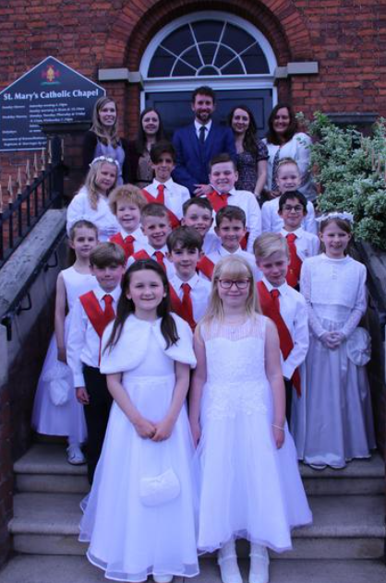
Preparing for Holy
Communion
The children will be preparing to receive Jesus in Holy Communion for the first time.
They will also be preparing to celebrate the Sacrament of Reconciliation (First Forgiveness).
This is a really important moment in their lives as members of God’s family – the Church.
As a school and a parish community, we want to help the children prepare in the best possible way.

Slide 4
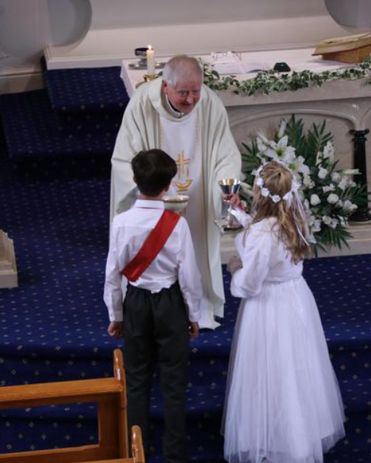
Enrolment Mass
Sunday 16th November
10.30am Mass
Children sit with their families
Wear school uniform
Children will be invited to the front 1 by 1 to receive their Holy Communion badge

Slide 5
Tuesday 4th November 2025 | 4:30pm | Parents’ meeting re Sacramental Preparation | School
Sunday 16th November 2025 | 10:30am | Enrolment Mass | Saint Mary’s Chapel
Wednesday 25th February 2026 | 3:15-4:00pm | Children’s communion classes begin | School
Tuesday 24th March 2026 | 6:30pm | First Forgiveness | Saint Mary’s Chapel
Saturday 16th May 2026 | 12:00pm | First Holy Communion | Saint Mary’s Chapel
Wednesday 20th May 2025 | 9:15am | May Procession | School

Slide 6


Preparing for Holy
Communion
A series of preparation sessions for children and parents.
Encouragement, prayer and preparation in the home.
Workbooks for each session which will be started in school but need to completed by children and parents together at home.
Prayer and ‘worship’ in the home and family are especially important at this time.

Slide 7

Heart Speaks to Heart
Heart Speaks to Heart is a resource that helps the children prepare for the Sacrament of Reconciliation and Holy Communion.
The book includes prayers, reading, activities and weekly virtues to help us grow in love and friendship with Jesus.
An important part of this resource is for children and parents to take time to learn together and to talk to each other: there will be suggested questions to answer, activities to do and topics to discuss. It’s also very important to be praying together as a family at home.

Slide 8

Heart Speaks to Heart
First Forgiveness
Session 1: Thankfulness: the Gift of Life
Session 2: Honesty and Bravery: God is Calling You
Session 3: Reflection: the Call to Love
Session 4: Friendship and Respect: Turning to God
Session 5: Love and Forgiveness: the Loving Heart of Jesus

Slide 9
Heart Speaks to Heart
First Holy Communion
Session 1: Faith: My Life’s Journey
Session 2: Hope: Entering God’s House
Session 3: Love: Holy Mass Begins
Session 4: Stillness: God Speaks His Word
Session 5: Generosity and Gratitude: Jesus Offers Himself for Us
Session 6: Courage: Food for the Journey
Session 7: Reflection: My Journey Continues

Slide 10
What can you do at home?
Complete activities in workbooks at home
The workbooks are time to reflect and a special keepsake
Pray together – Special prayer place
Keep a prayer journal

