Slide 1
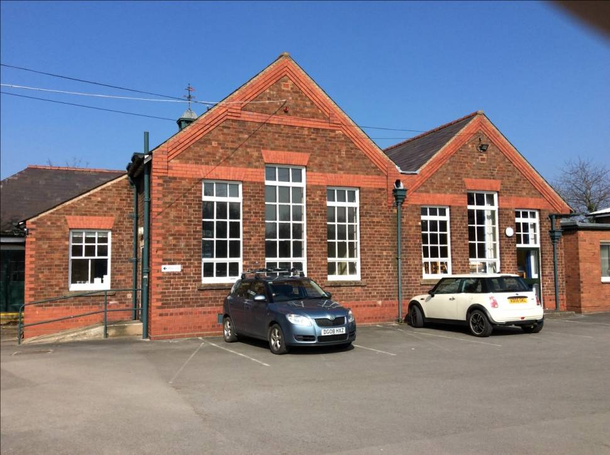
Saint Mary’s Year 4 residential to Tattenhall
21st - 23rd April 2026

Slide 2
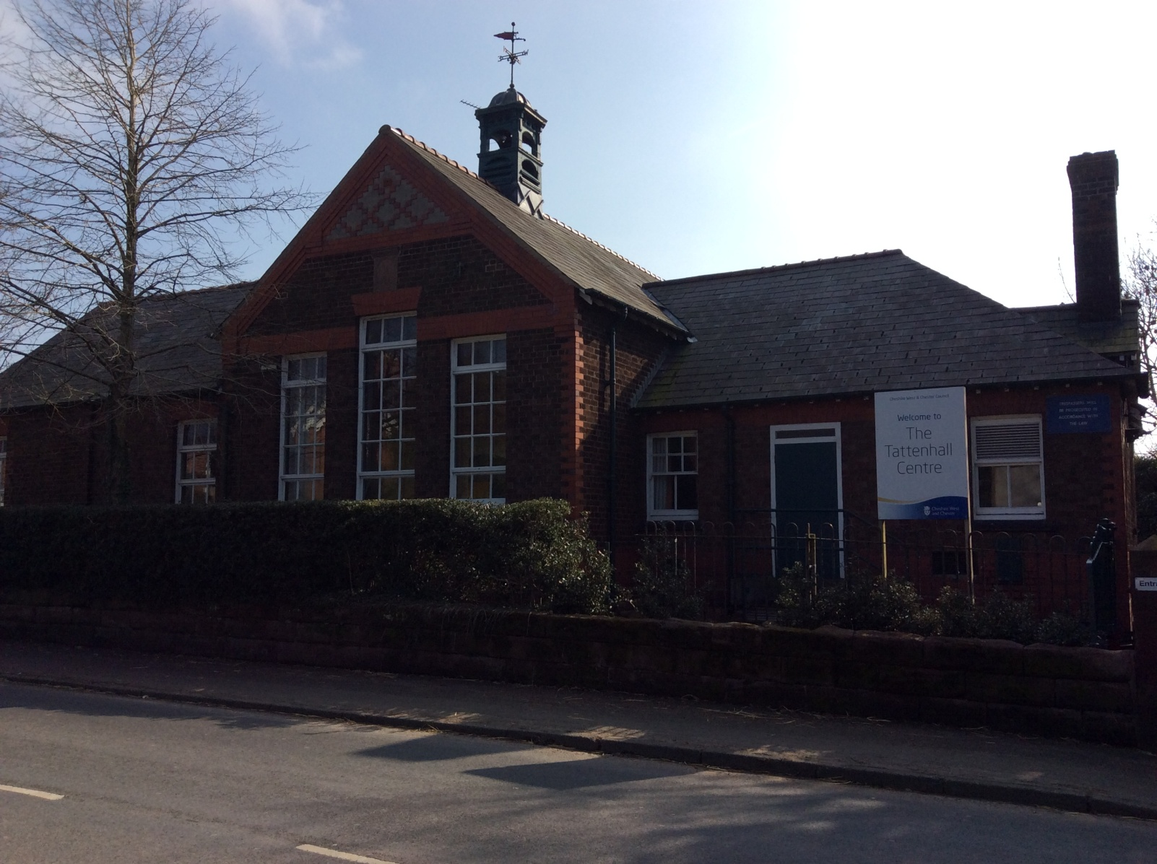
Tattenhall Residential Centre

Slide 3
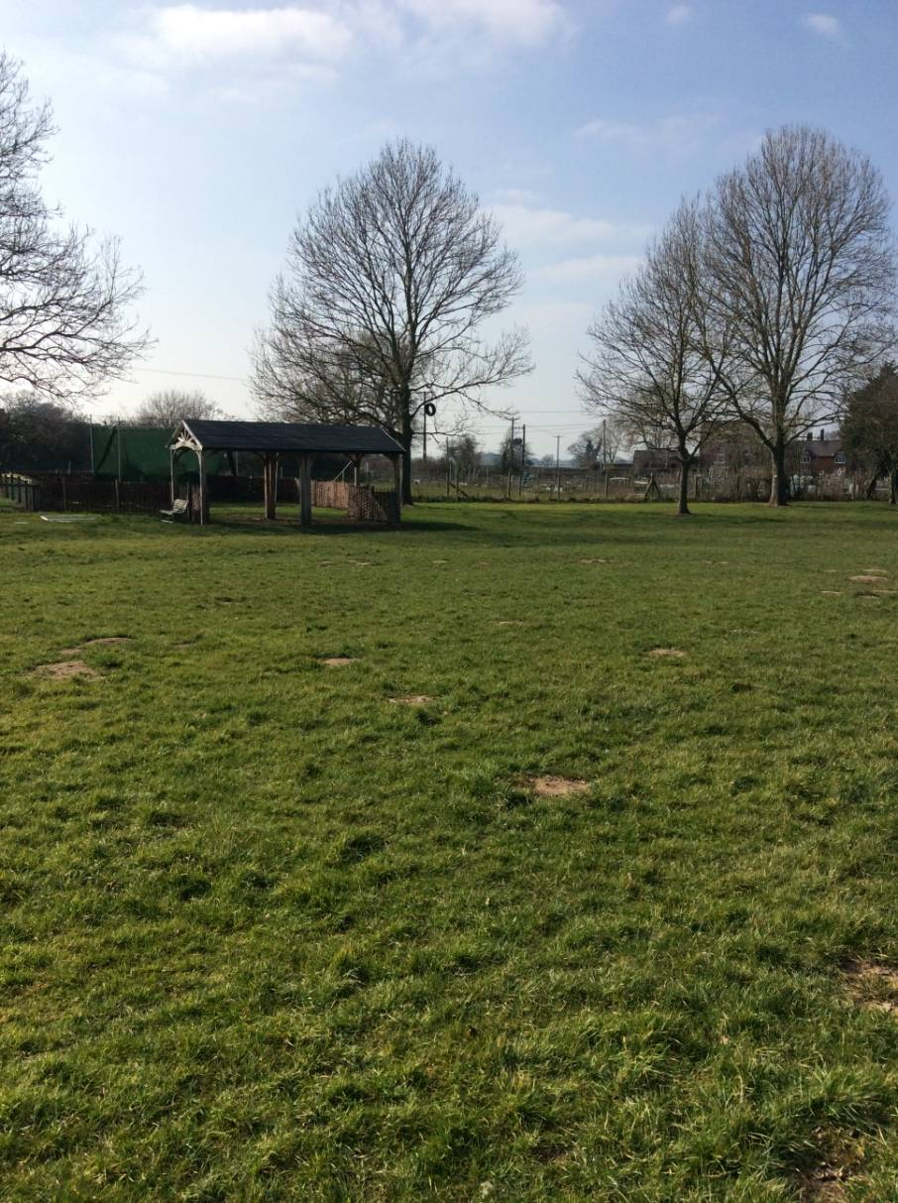
General Information
Staff involved over the 3 days
Miss Butterfield
Mrs Burrow
Miss Small
Address of accommodation
Tattenhall
High Street
Tattenhall
Chester
CH3 9PX
Phone: 01829 770223

Slide 4
Transport
The children will be travelling on Bostocks Coaches with Mrs Burrow and Miss Small.
Miss Butterfield will be driving to Tattenhall and her car will stay there in case of an emergency.

Slide 5
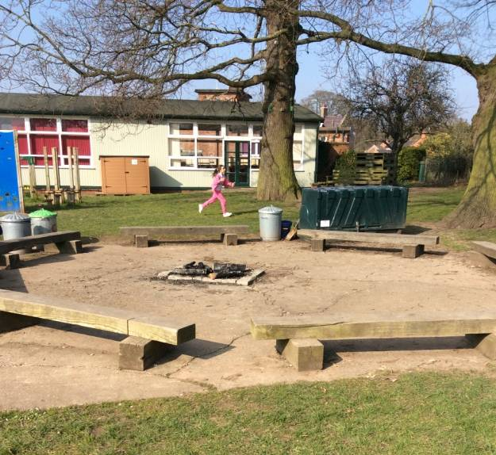
Activities
All activities will be led by centre staff and Saint Mary’s staff will be on the site for all of these activities. The activities over the three days include;
Team building
Art
STEM
Zip wire/ rope swing/ tree climb
There will also be time for the adventure playground, games on the field, toasting marshmallows and downtime such as board games and colouring.

Slide 6
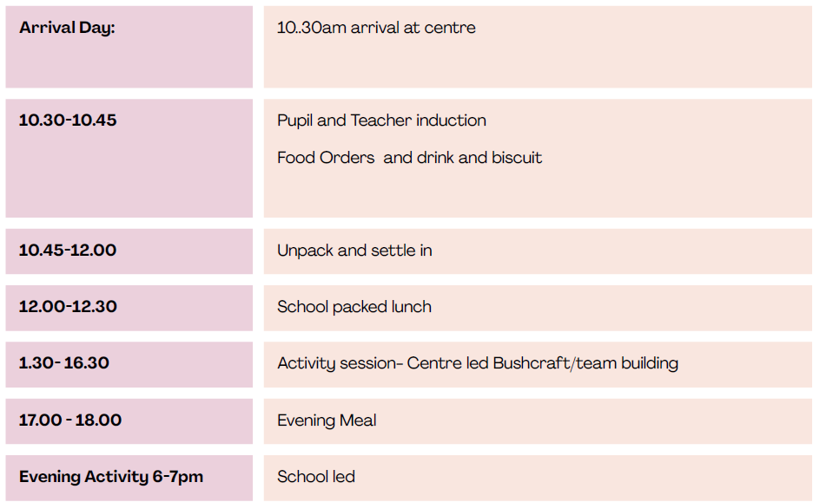
Itinerary: Tuesday 21st April
08:35-08:45 Arrive at school (Leave bags outside the classroom)
09:15-09:30 Depart School

Slide 7
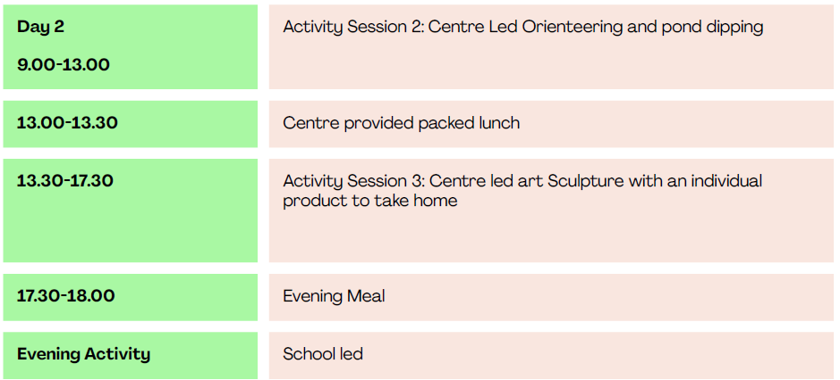
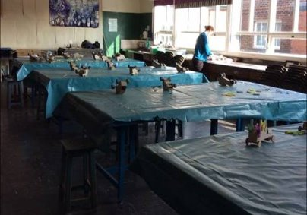
Itinerary: Wednesday 22nd April
08:00 Breakfast

Slide 8
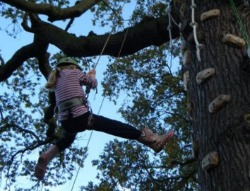
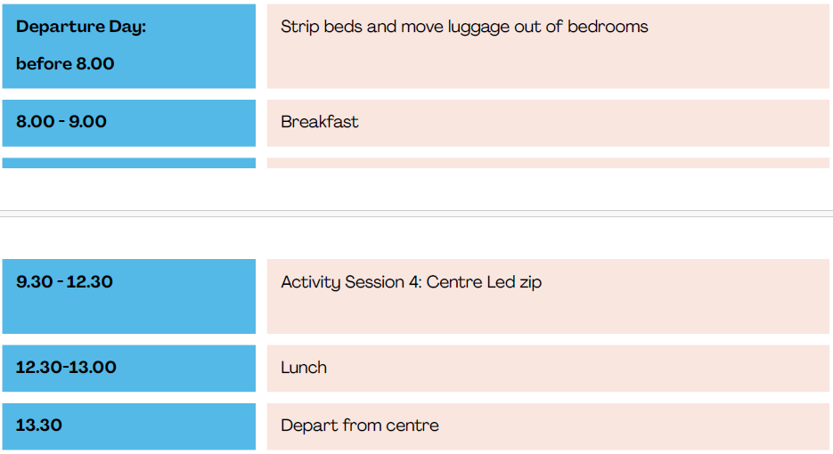
Itinerary: Thursday 23rd April

Slide 9
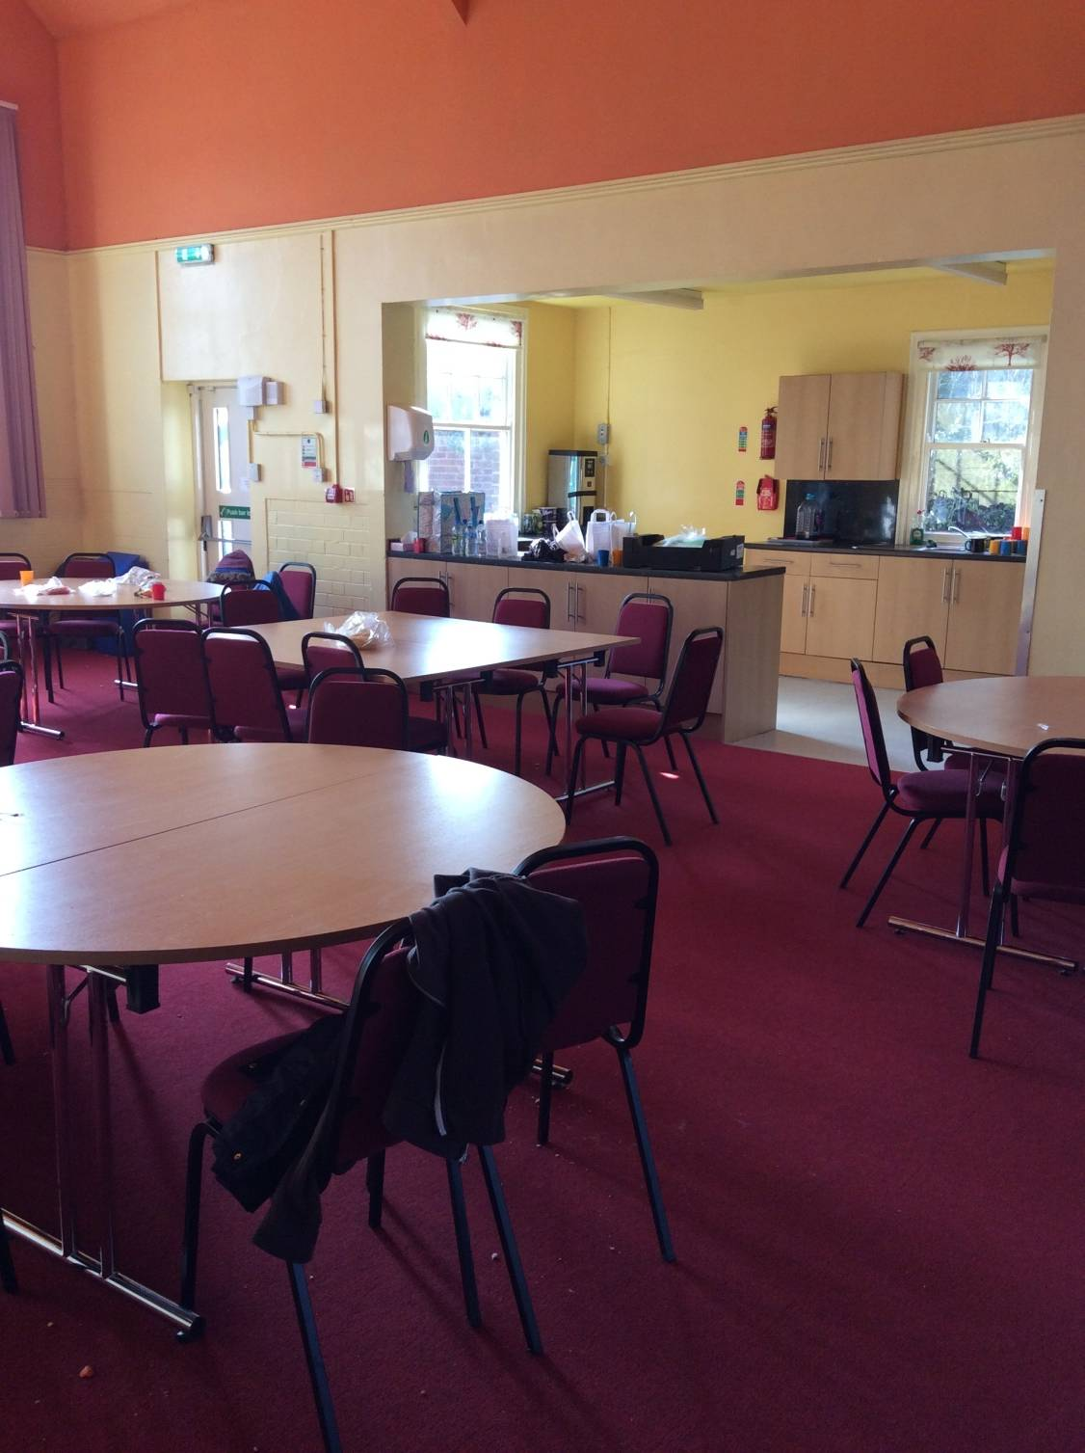
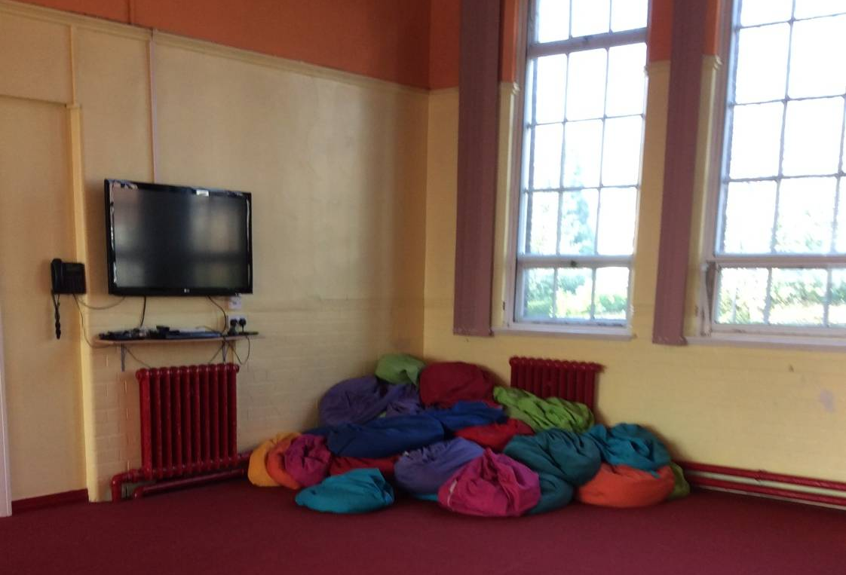
The Social
Room

Slide 10
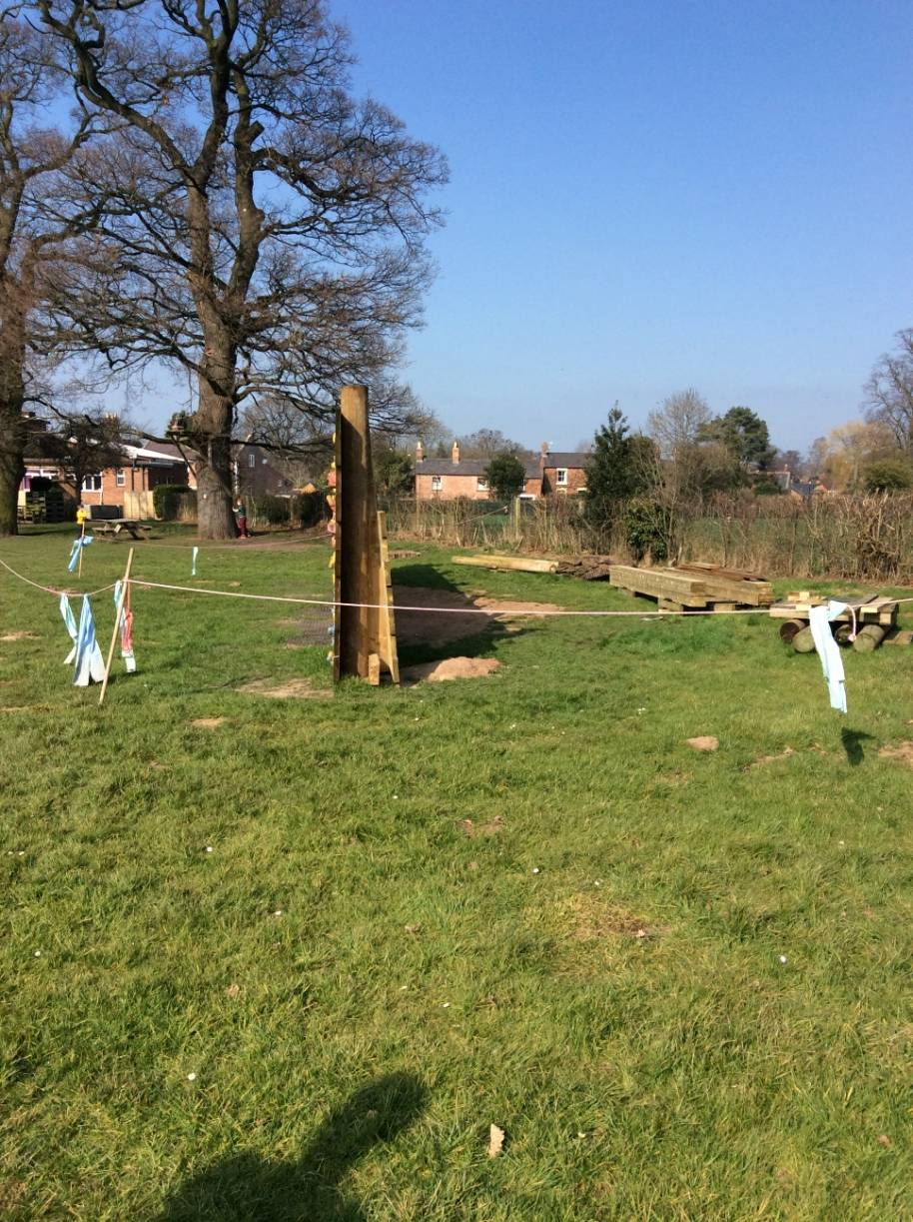
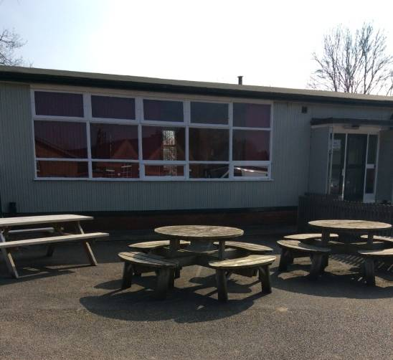


The Outdoor Space

Slide 11
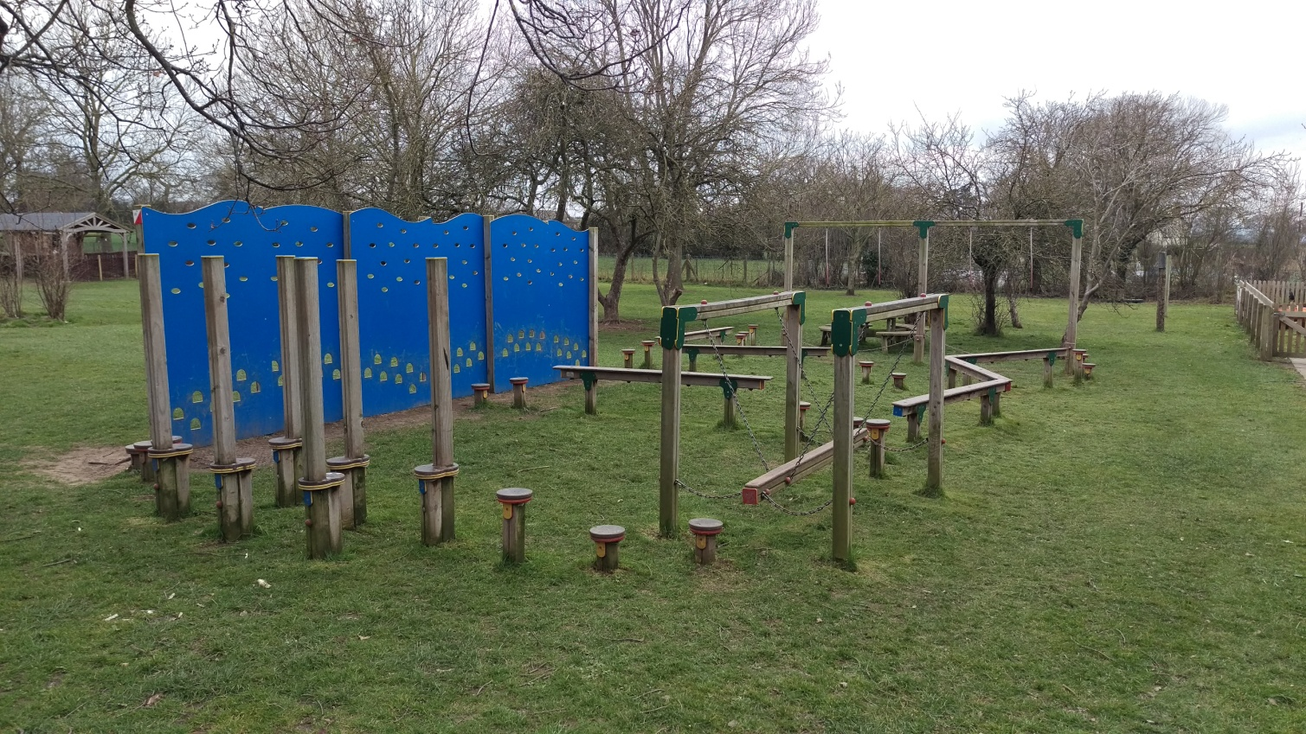
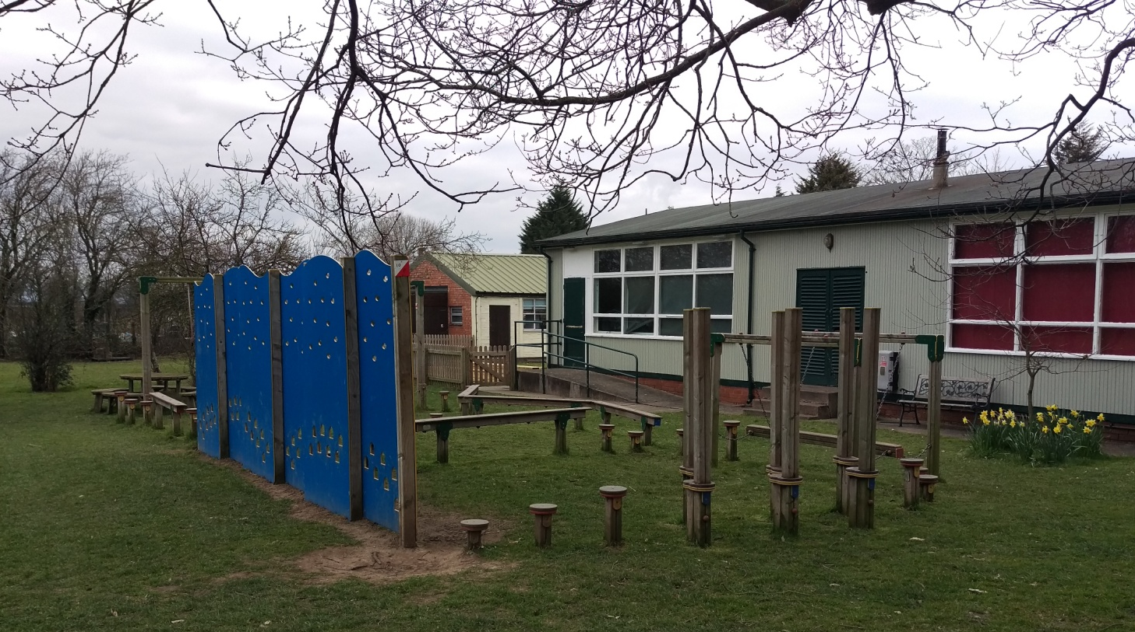

Slide 12
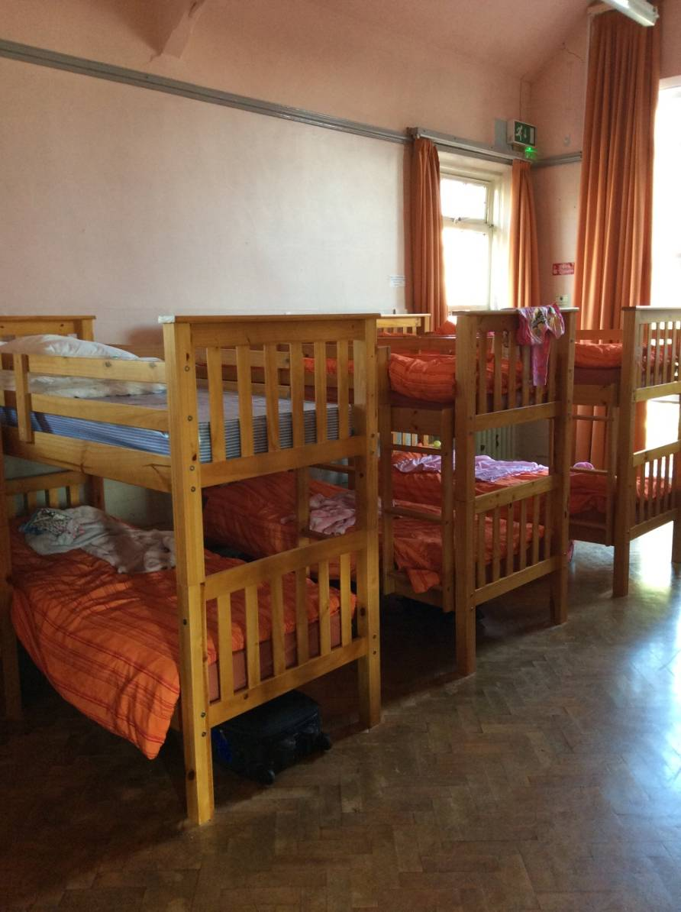
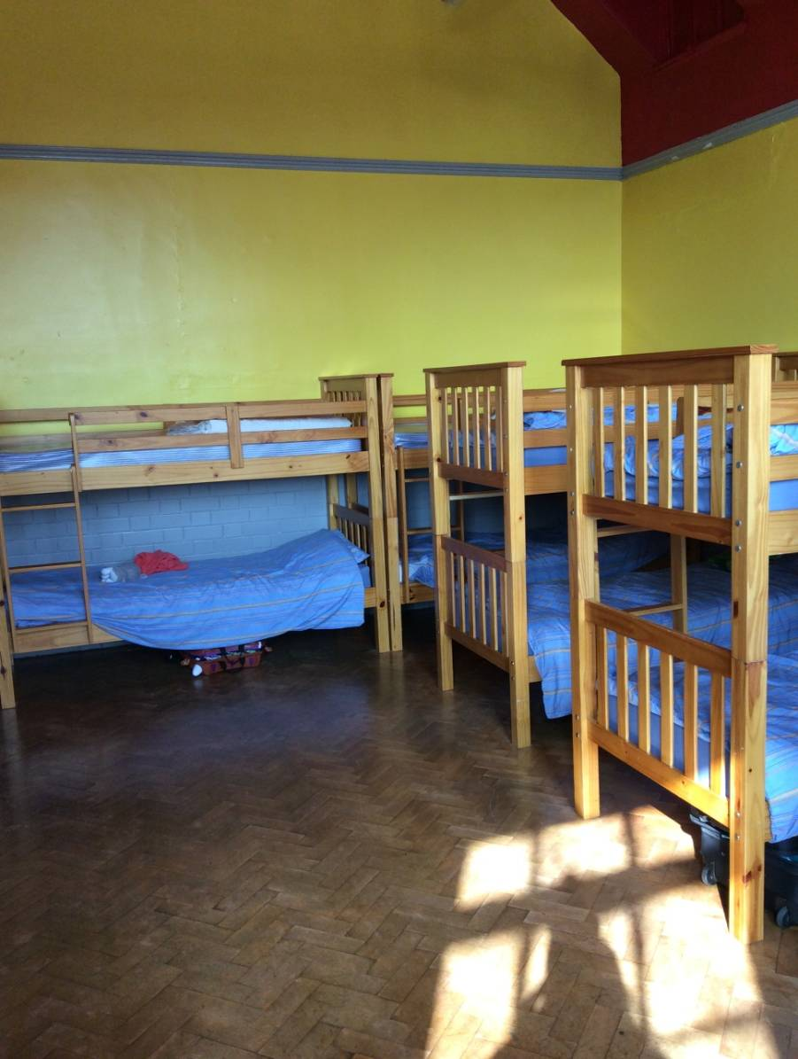
The Bedrooms

Slide 13
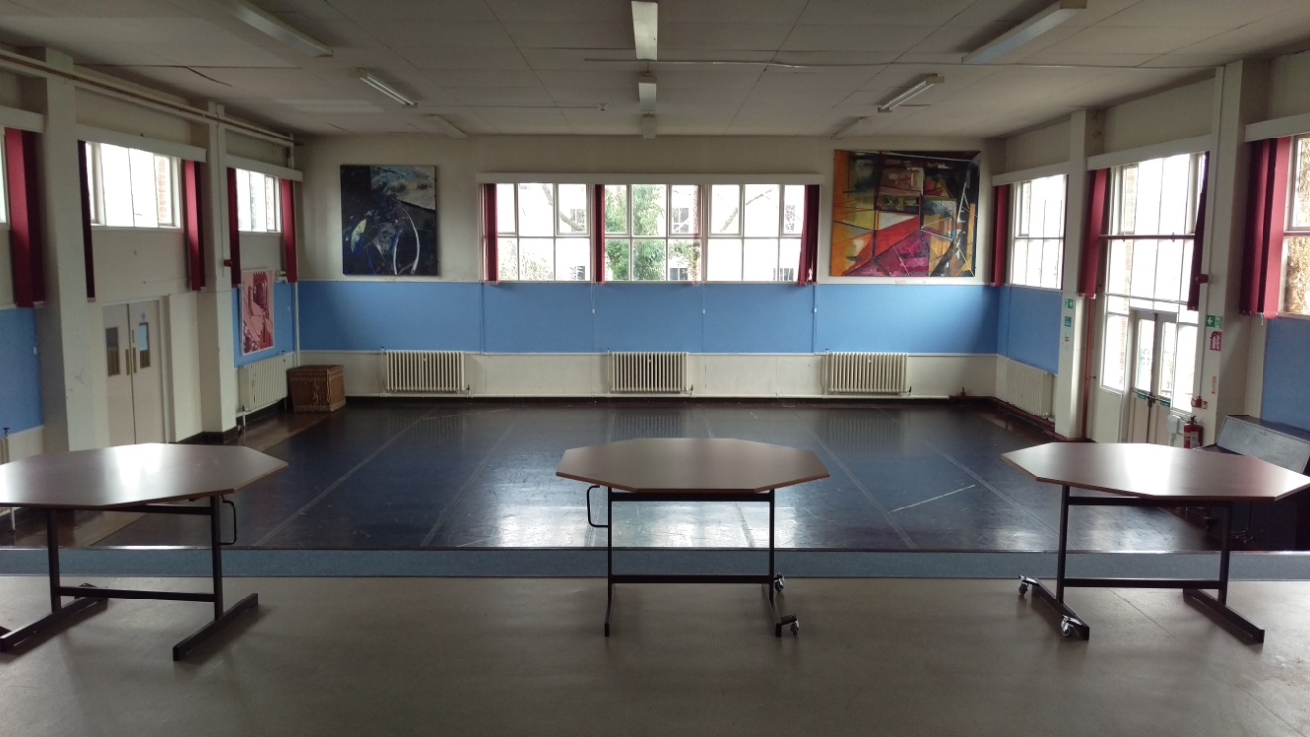
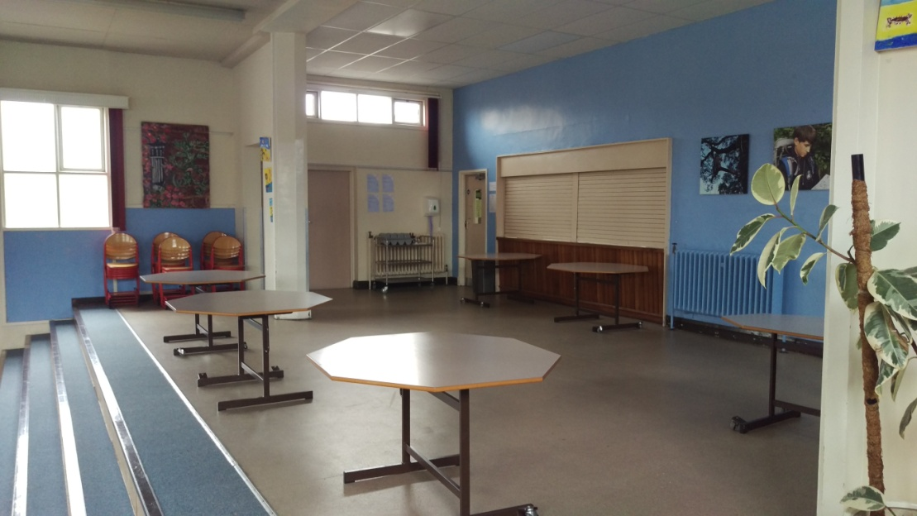
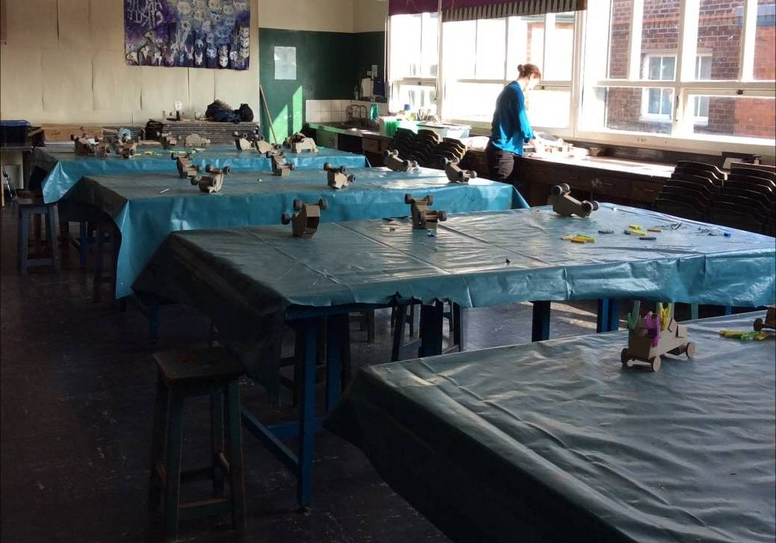
The dining room, art studio and dance hall

Slide 14
Catering
Breakfast
A selection of cereals, juice and yoghurts are in the dining room, followed by a hot option served at 8.15 am.
Lunch
Lunch is sandwiches, crisps, fruit or yoghurt and a hot option.
Evening Meal
The main meal is a 2-course meal with 2 options.
Snacks
Tea, coffee, squash, milk, hot chocolate, biscuits and toast are available at all times from the dining room.
Special Diets
Centre staff have a wealth of experience in providing meals for all sorts of allergies and intolerances from mild to serious conditions. If your child has any allergies please write these on the medical form and we will let the centre know.

Slide 15
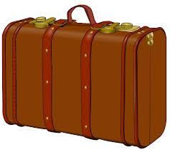
Children’s Kit List
A large holdall is preferable/ small suitcase will be adequate.
Please label the holdall/suitcase and all possible items of clothing.
Towel
Toilet bag containing:
  Toothbrush;
  toothpaste;
  soap;
  flannel;
  hairbrush;
Pyjamas and slippers (Children will wear slippers inside the centre
rather than their outdoor shoes)
Socks and underwear (3-4 pairs).
Suitable clothing.
Waterproof jacket.
Old trainers.
Carrier bag for dirty clothes.
Sunhat and sun cream.
It is important your child watches you pack their case so they know exactly what they have packed and what clothes are theirs.

Slide 16
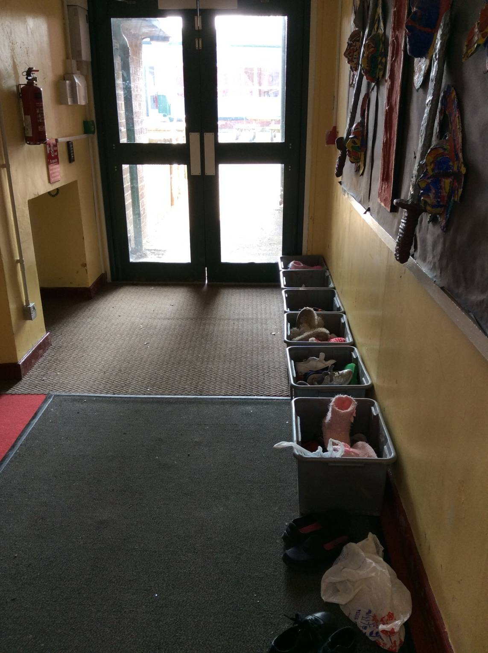
The centre have asked the children leave their outdoor shoes in these containers and change into indoor shoes or slippers when inside.

Slide 17
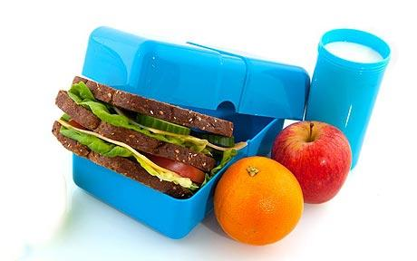

Also....
A packed lunch for the first day. This should be in a disposable bag and clearly named.
1 teddy bear.
1 book.
Pencil case/ colouring if your child would like to.
Please note electronic devices are not allowed.

Slide 18

Communication
Mrs Burrow will contact the school asap on arrival at Tattenhall.
Mrs Burrow will also be in contact with the school over the return time of the party should it vary significantly from the itinerary.
Mrs Burrow will add pictures to class dojo over the few days.
Please ensure you have completed the medical forms so we have all emergency contact details for yourselves.

Slide 19

Behaviour and Conduct
Children will be briefed before the trip of the standard of behaviour we expect of them.
Any cases of inappropriate behaviour will be dealt with in accordance with our behaviour policy and after the trip if necessary.
In cases of extreme inappropriate behaviour during the trip the school may notify parents in order to obtain their help with resolving the situation.

Slide 20

Health and Safety
The trip has been approved by Cheshire West’s educational visits department.
Risk assessments have been constructed and all adults involved will have a copy.
Children will be briefed on health and safety issues such as fire procedures in the accommodation (on arrival)
We will be the only school visiting the site. All doors are protected by a security code, which is changed after every visit.
Staff will set an alarm so should a door be opened an alarm will sound.
The school has full travel insurance through the tour operator.

Slide 21

Medicines
Please send medicines mentioned on the medical form to the school office before the trip in a clearly labelled and preferably sealed sandwich style bag.

Slide 22

Any Questions?

