Slide 1


Saint Mary’s Catholic Primary School
MEET THE TEACHER
SEPTEMBER 2026
YEAR 1

Slide 2
Year
1
Class Teacher
Miss Owen
Teaching Assistants
Mrs Aidley

Slide 3
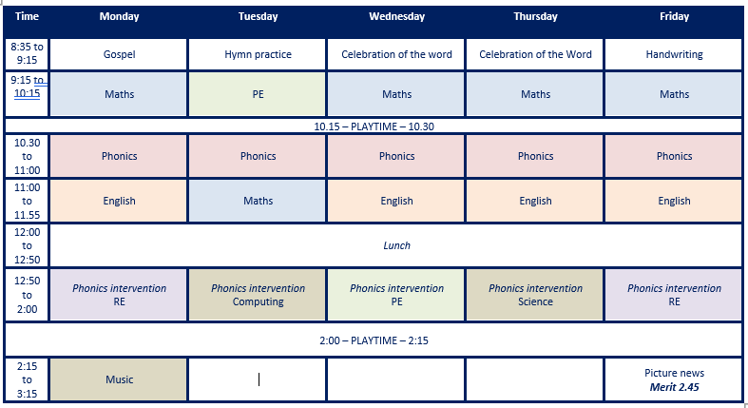
Timetable

Slide 4






English
  This will be taught through the Pathways to Write Scheme. All units are linked to high-quality texts to ensure engaging and purposeful lessons are delivered.
  The units of work are aimed to develop vocabulary, reading and writing skills through the mastery approach.
  The scheme includes strategies to develop Greater Depth writers.
AUTUMN 1 –Meesha Makes Friends
AUTUMN 2 – Katie in London
SPRING 1 –The Lion Inside
SPRING 2 –Beegu
SUMMER 1 – Someone Swallowed Stanley
SUMMER 2 – Midsummer Nights Dreams

Slide 5
Your child will read in school with children who are at a similar level of phonics knowledge to them. At the end of the week, the Group Reading book (Monster Phonics) will be sent home to further practise reading. As each child has already read the book in school, we recommend that they independently read the book to an adult at home, receiving support where necessary.
Guided Reading

Slide 6
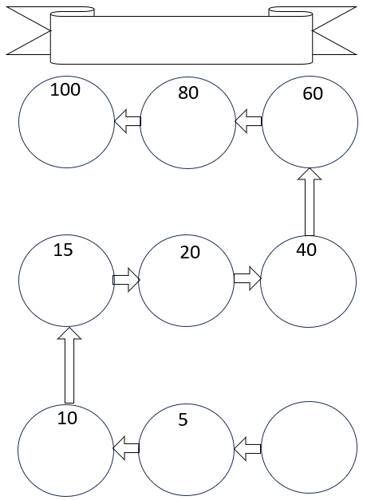

Our reading reward system!
Reading
Each child will be given a card and they can collect stickers and class dojos based on the number of reads at home that they have completed.

Slide 7
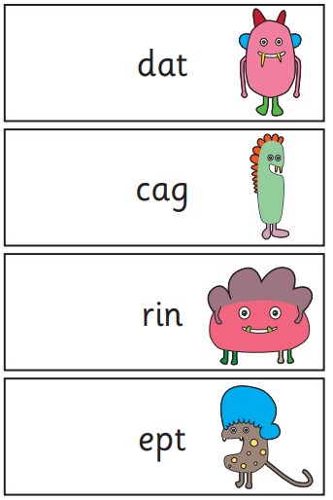
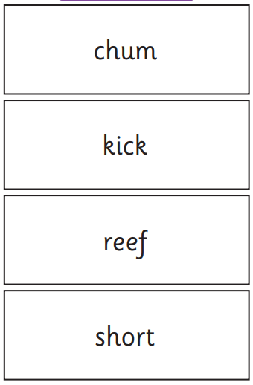
  Phonics is very important and at the end of Year 1 the children will take part in the Phonics Screening Check.
Phonics
It is designed to give teachers and parents information on how your child is progressing in phonics.
It checks children's ability to:
sound out and blend graphemes in order to read simple words.
read phonically decodable one-syllable and two-syllable words, e.g. cat, sand, windmill.
read a selection of nonsense words which are referred to as pseudo words.

Slide 8
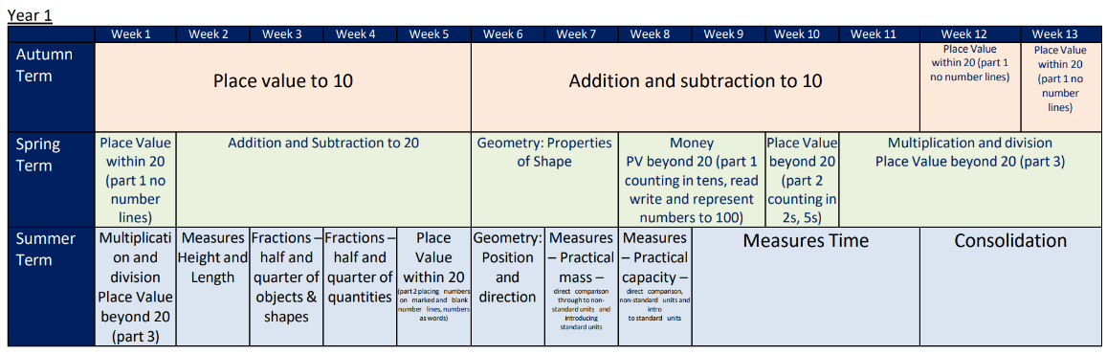
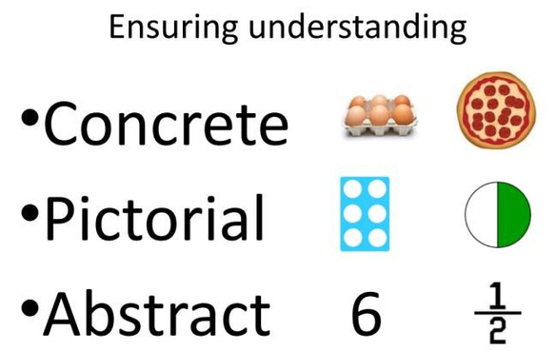
Maths

Slide 9
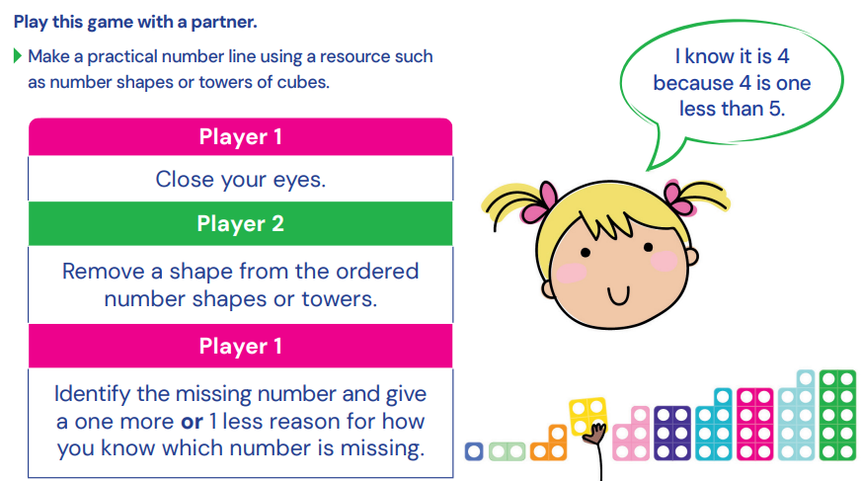
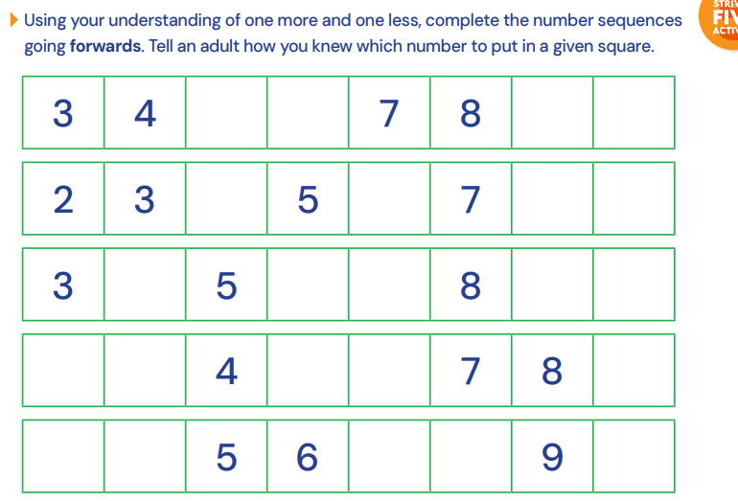
Maths.
VARIED FLUENCY

Slide 10
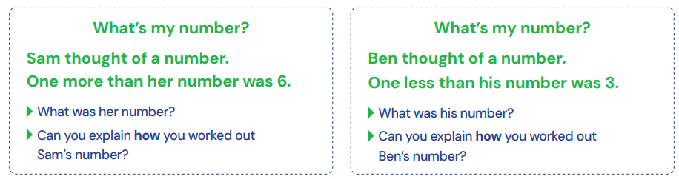
Maths.
REASONING AND PROBLEM SOLVING

Slide 11

Foundation Subjects
  You will find termly information on Science, History, Geography, Art and D&T on our webpage.
  You will be able to read the knowledge organisers for each subject that we are doing for that half term.

Slide 12





What can you do to help?
  Read regularly with your child- school books, books at home, library books, online books, magazines, newspapers, ANY THING!
  Question your child about what they have read and encourage them to use their developing phonics knowledge to decode unfamiliar words.
  Maths.co.uk- Use the login details to access the Maths.co.uk
  The use of these websites will be reviewed this year as we continually assess and monitor the best resources we can make available. We shall be sticking logins into the children’s reading records.
  Letter-Join: Cursive handwriting practise, resources to support this on the website.

Slide 13
Phonics booster sessions will start after Christmas time to help the children in the build up to the phonics screening check.
Boosters and interventions

Slide 14
Expectations
  Please ensure that all clothing and belongings are clearly named.
  Children are to wear either their summer or winter uniform until October half term, but after this
  time they must be in winter uniform.
BEHAVIOUR AND
  No trainers are allowed, except on PE days
EXPECTATIONS
(children should come into school in their PE kids on a Tuesday). No jewellery.
  Please ensure your child has a labelled
  water bottle in school daily.

Slide 15

Behaviour
  We follow our Golden Promises and these are shared in assembly and in class so that everyone understands how we behave at Saint Mary’s.
  If any issues arise that we need to discuss with you then you will be contacted. The behaviour policy is on the website.
BEHAVIOUR
AND EXPECTATIONS
Expectations
  All clothing and belongings to be clearly named eg lunchbox, snack boxes, water bottles, caps.
  Children to come into school in the correct uniform eg only trainers on PE days. Jewellery should not be worn. Hair to be tied up if longer than shoulder length.

Slide 16
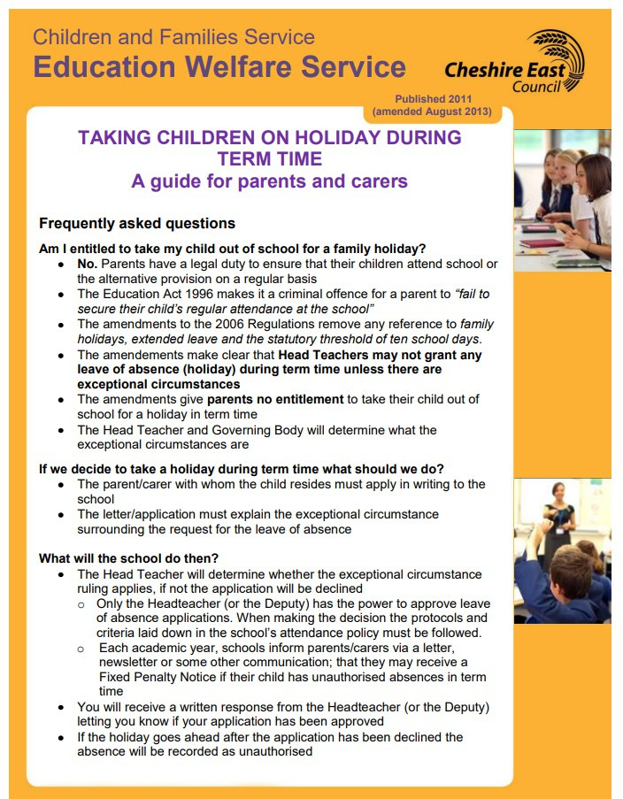
ABSENCE AND ATTENDANCE

Slide 17
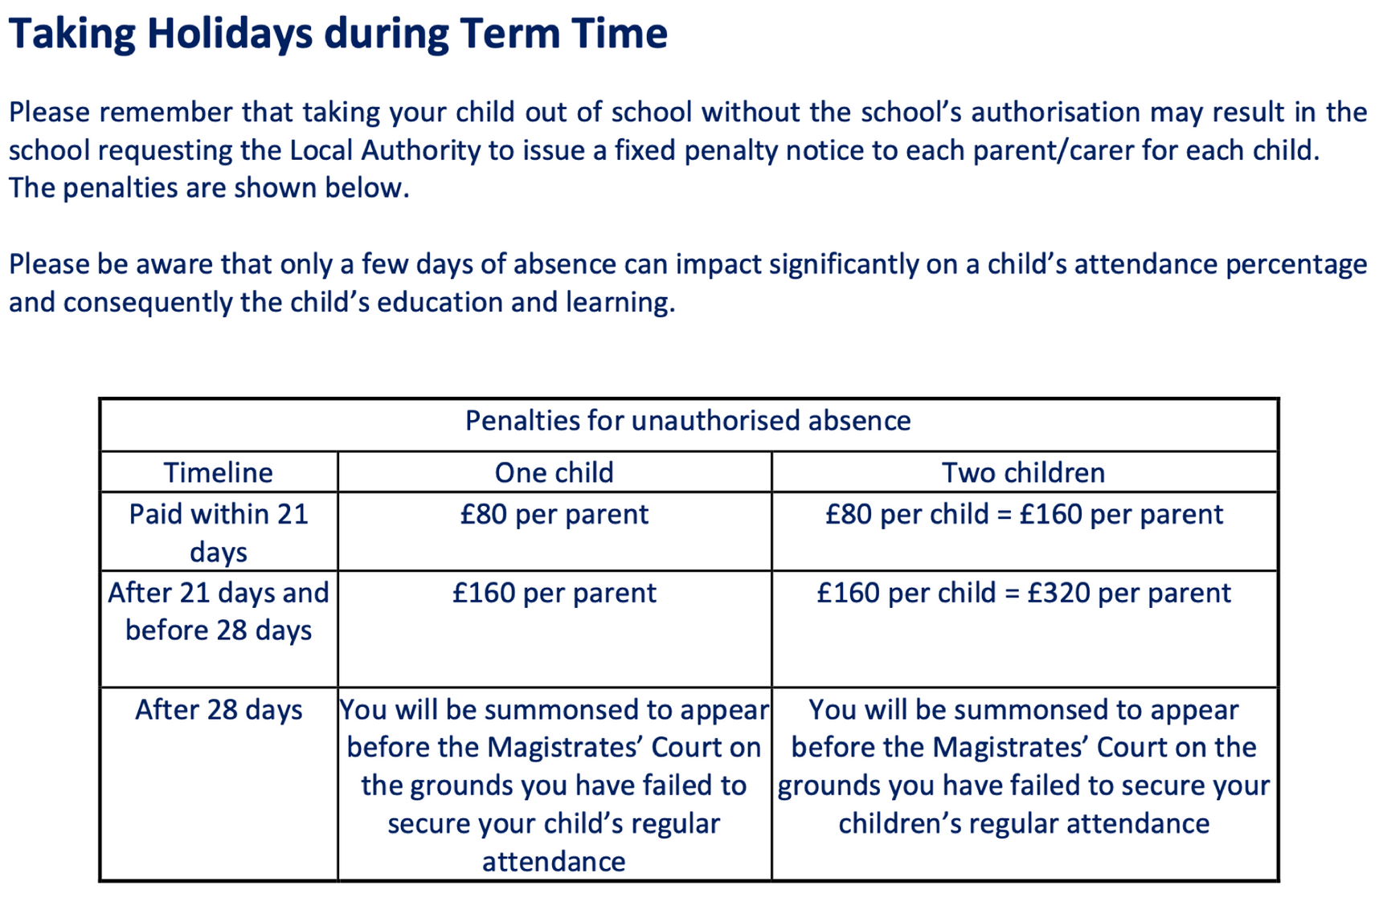
IF YOUR CHILD IS ABSENT PLEASE CALL SCHOOL IN THE MORNING AND LEAVE A MESSAGE
CHILDREN ARE NOT TO RETURN TO SCHOOL UNTIL 48 HOURS AFTER LAST BOUT OF SICKNESS AND DIARRHOEA.

Slide 18
  If your child has any allergies or requires medication during the school day, please ensure we are kept fully informed of these.
IMPORTANT INFORMATION
  In relation to any medicines, please ensure the relevant forms are completed and signed from the office and all medication provided is within date.
  We do not allow nuts or products that contain nuts in school. This is to ensure all of our children are kept safe at all times.
  Please leave toys at home!
  Nits- please ensure you check your children's hair regularly, inform us if these are discovered and treat these immediately.
  In relation to break time snacks, please ensure these are healthy and are of a suitable size.

Slide 19
  If you need to contact us we have an open door policy at all times.
CONTACT
  You can contact us by email on admin@saintmaryscongleton.co.uk
  We are also available for phone calls too and these can be arranged through the school office and will have regular parents evenings when progress and any concerns can be discussed.

Slide 20
Thank you!
DO YOU HAVE ANY QUESTIONS FOR ME BEFORE WE GO?

